Slide 1
An Age of Reforms

Slide 2
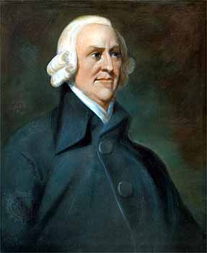
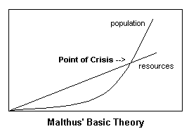
The Philosophers of Industrialization
Laissez-faire economics
Refers to the economic policy of letting owners of industry and business set working conditions w/o interference. (French phrase meaning “let do”)
Adam Smith claimed that economic liberty guaranteed economic progress, NO need for government interference.
The ideas of Malthus and Ricardo
Basic ideas led to capitalism
Malthus: population always grew faster than food → need wars and epidemics
Ricardo: believed that a permanent underclass would always be poor.
Wages would be forced down as population increased.

Slide 3
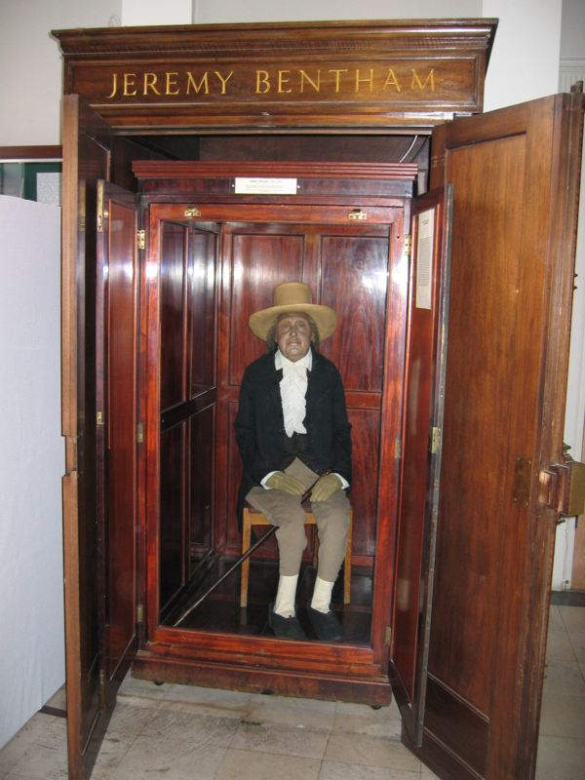
Rise of Socialism
Utilitarianism
Introduced by Jeremy Bentham: People should judge ideas, institutions, and actions on the basis of their utility, or usefulness.
Gov’t. to promote the greatest good for the greatest number of people.
John Stuart Mill led the movement
Believed that the working class needed to be helped.
Favored a system with equality (women’s rights, prison, education)

Slide 4
Socialism and Marxism
Socialism
Charles Fourier, Saint-Simon
The factors of production are owned by the public and operate for the welfare of all
The government should actively plan the economy
Control of factories, mines, railroads would abolish poverty and promote equality
Public ownership would help the workers, who were at the mercy of greedy employers.
Marxism/Communism
Human societies have always been divided b/w warring classes
“Haves” (bourgeoisie) vs. “Have-nots” (proletariat)
“Have-nots” will always overthrow the “Haves”
Final phase of proletariat take over lead to pure communism
Complete socialism where means of production would be controlled by the people.

Slide 5
Reform Movements
Abolition of Slavery
William Wilberforce of England’s Parliament morally hated slavery
Pushed for abolition and continued the fight after he retired until abolition ended in 1833.
Others saw it as an economic threat
Cheap labor rather than slave labor
U.S. abolished slavery after Civil War to fulfill promise of DOI
Women Fight for Change
Fought for equal pay
Jane Addams set up Hull House to help house working women and trained social workers.
Horace Mann → father of public education
Alexis de Tocqueville → prison reform
Restoring prisoners to useful lives

Slide 6
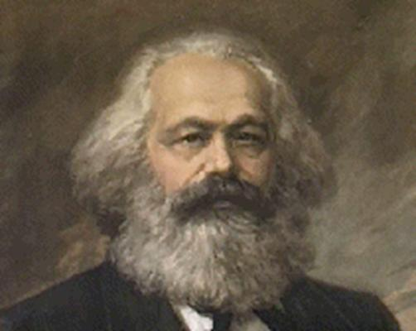
Communism Continued
At first, the ideas from the pamphlets did not catch on but it later influenced revolutionaries such as Lenin (Rus), Zedong (China), Minh (Viet), Castro (Cuba)
Also, some predictions were wrong:
Economic forces do not dominate society → religion, nationalism, etc.
Gap b/w rich and poor w/in industrialized nations failed to widen in the way of their predictions.

Slide 7
Unions
Working people became more involved in politics
In order to press for reforms, workers joined unions: voluntary association of workers
Engaged in collective bargaining: negotiations between workers and their employers
Bargained for higher wages and better working conditions
If owners refused the changes, workers went on strike!! Workers would then refuse to work!!

Slide 8
Karl Marx – The Pamphlet
Your task is to design a 4 page pamphlet that could be handed out on a street to introduce Marxism to people and recruit their support. The pamphlet should be illustrated and attractive.
Page 1 (the cover) an attention grabber
Page 2 – a description of the problems facing workers
Page 3 – Karl Marx’s remedy – what should happen, how will that happen
Page 4 – a call for action/support, what you want your reader to do and at the bottom of the page who prepared the pamphlet

