Slide 1
Characteristics
of
Renaissance Art

Slide 2
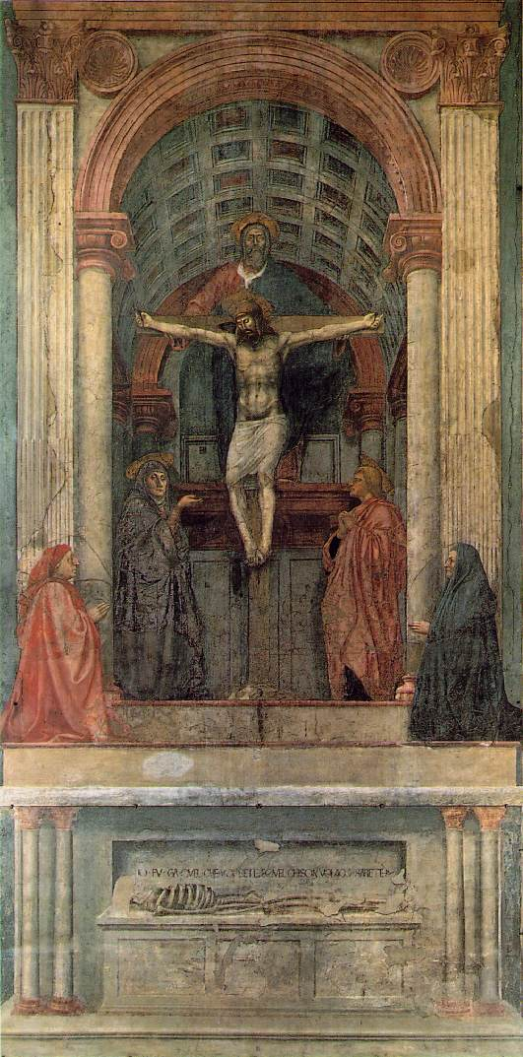
1. Perspective
The Trinity
Masaccio
1427
Perspective!
Perspective!
Perspective!
Perspective!
Perspective!
Perspective!
Perspective!
First use of linear perspective!
What you are, I once was; what I am, you will become.

Slide 3
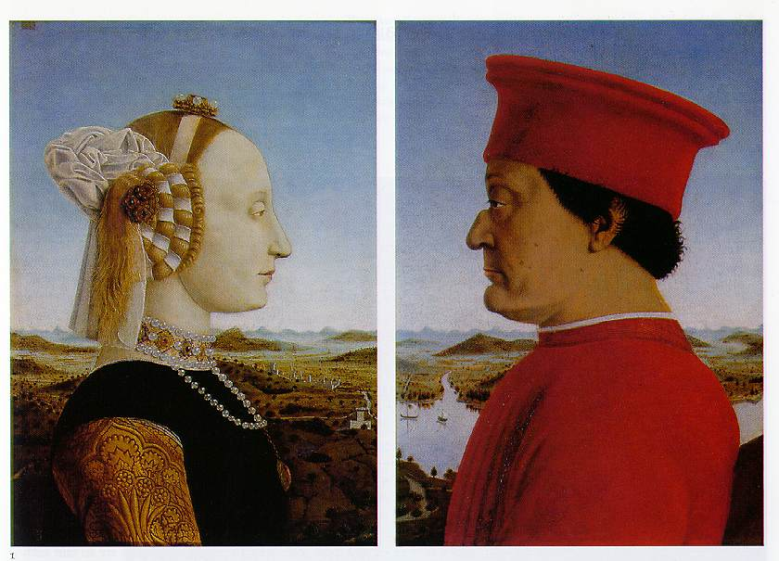
2. Emphasis on Individualism
Batista Sforza & Federico de Montefeltre: The Duke & Dutchess of Urbino
Piero della Francesca, 1465-1466.

Slide 4
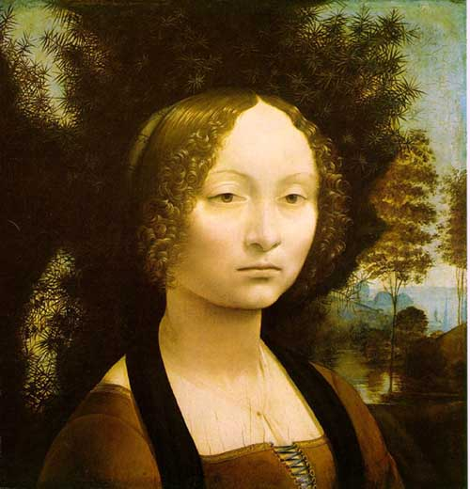
3. Light & Shadowing/Softening Edges
Sfumato
Chiaroscuro

Slide 5
Famous Renaissance Artist

Slide 6
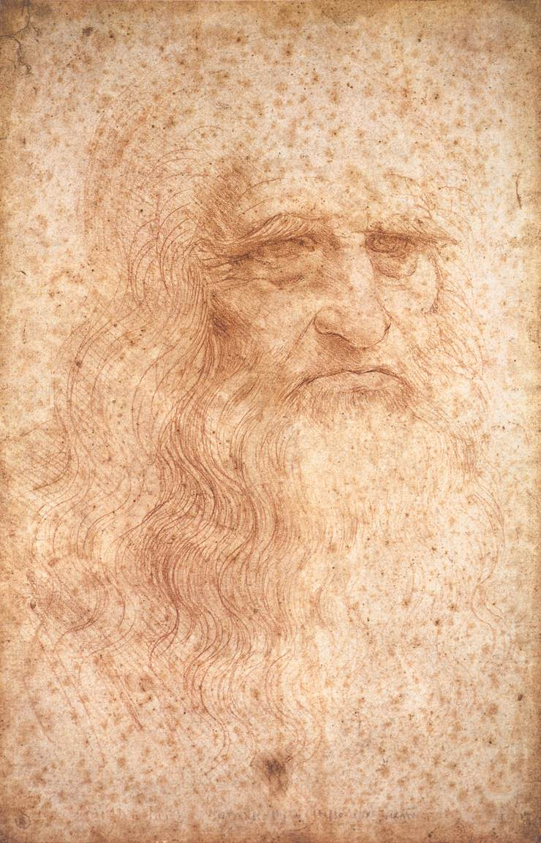
1. Leonardo da Vinci, 1452 - 1519
Artist
Sculptor
Architect
Scientist
Engineer
Inventor
Self-Portrait

Slide 7
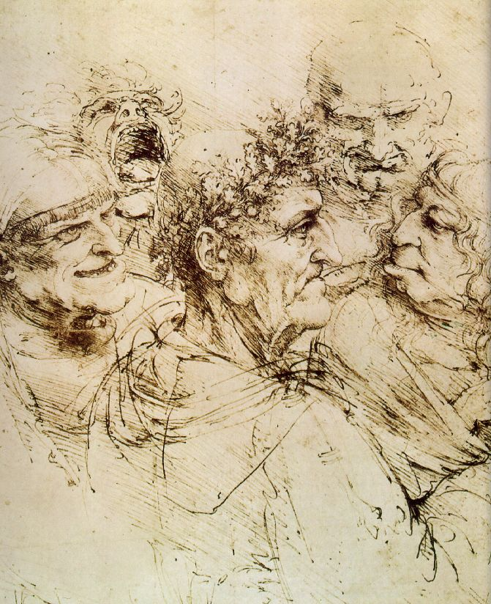
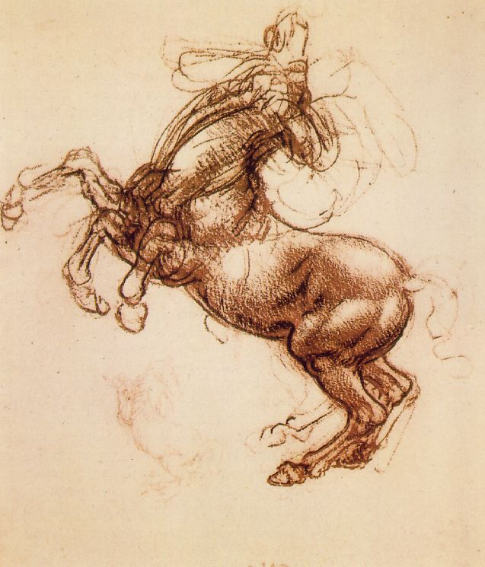
Leonardo, the Artist: From his Notebooks of over 5000 pages (1508-1519)

Slide 8
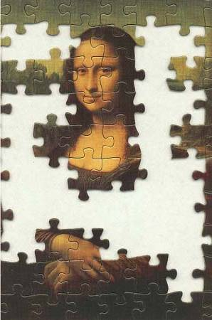
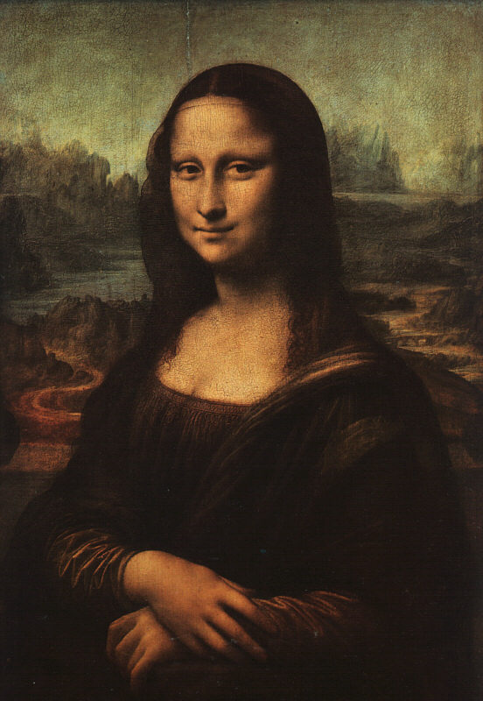
Mona Lisa – da Vinci, 1503-4
?

Slide 9
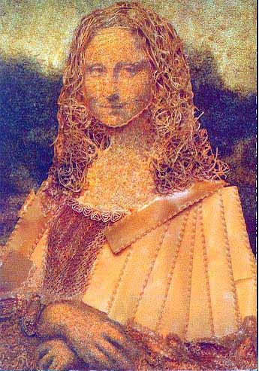
Parody→The Best Form of Flattery?
A Macaroni Mona

Slide 10
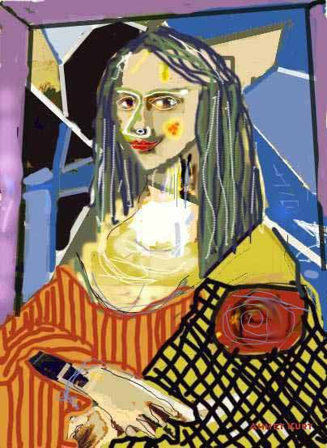
A Picasso Mona

Slide 11
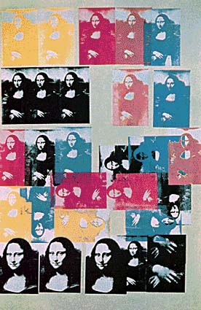
An Andy Warhol Mona

Slide 12
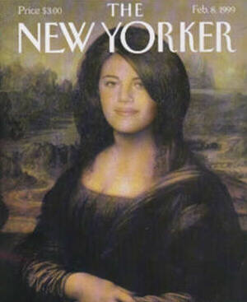
A “Mona”ca Lewinsky

Slide 13
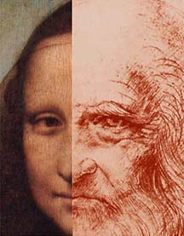
Mona Lisa OR da Vinci??

Slide 14
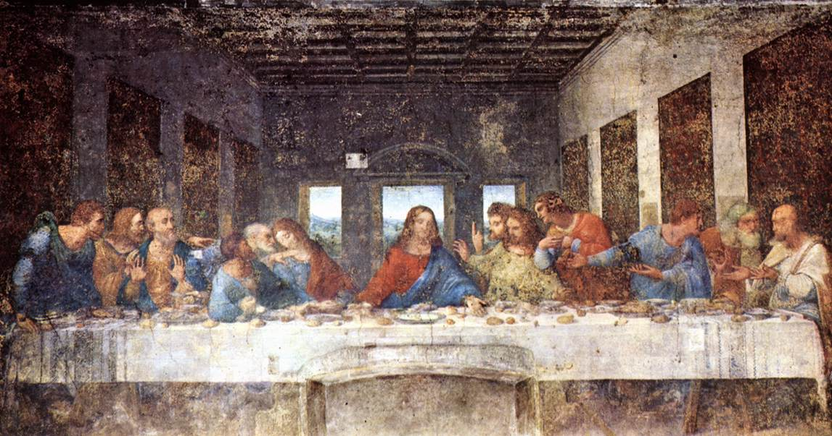
The Last Supper - da Vinci, 1498 & Geometry

Slide 15
The Last Supper - da Vinci, 1498
vertical
horizontal
Perspective!

Slide 16
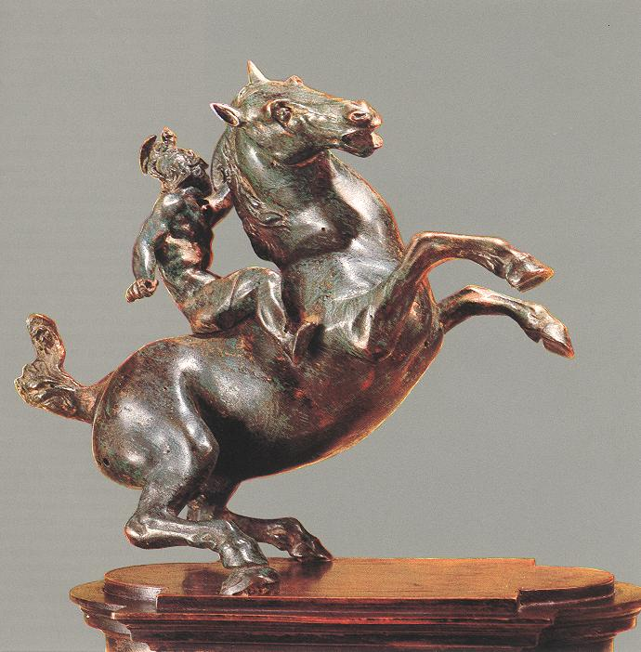
Leonardo, the Sculptor
An Equestrian Statue
1516-1518

Slide 17
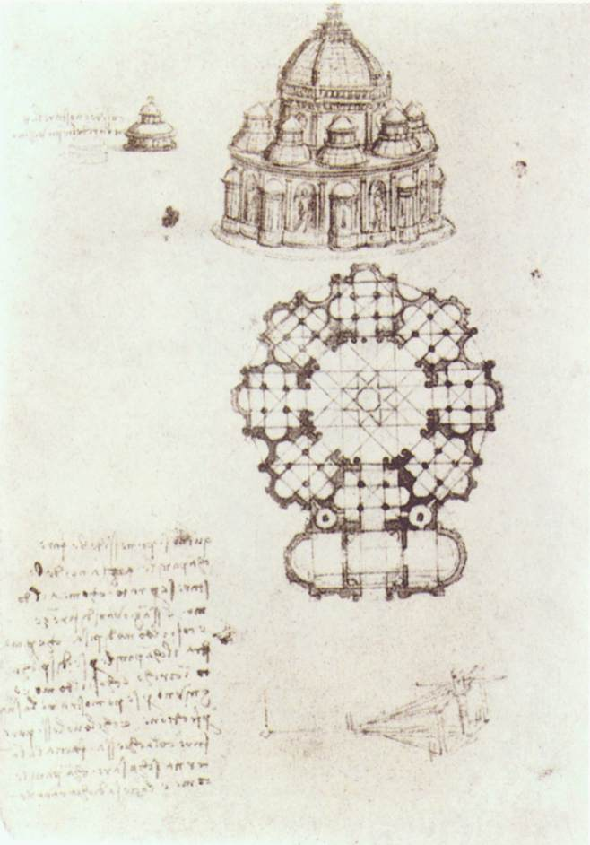
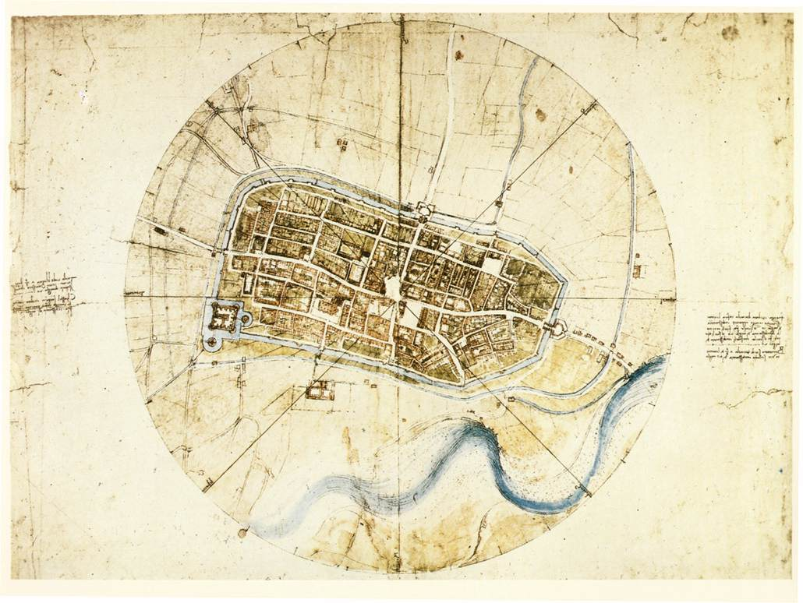
Leonardo, the Architect: Pages from his Notebook
Study of a central church
1488
Plan of the city of Imola, 1502.

Slide 18
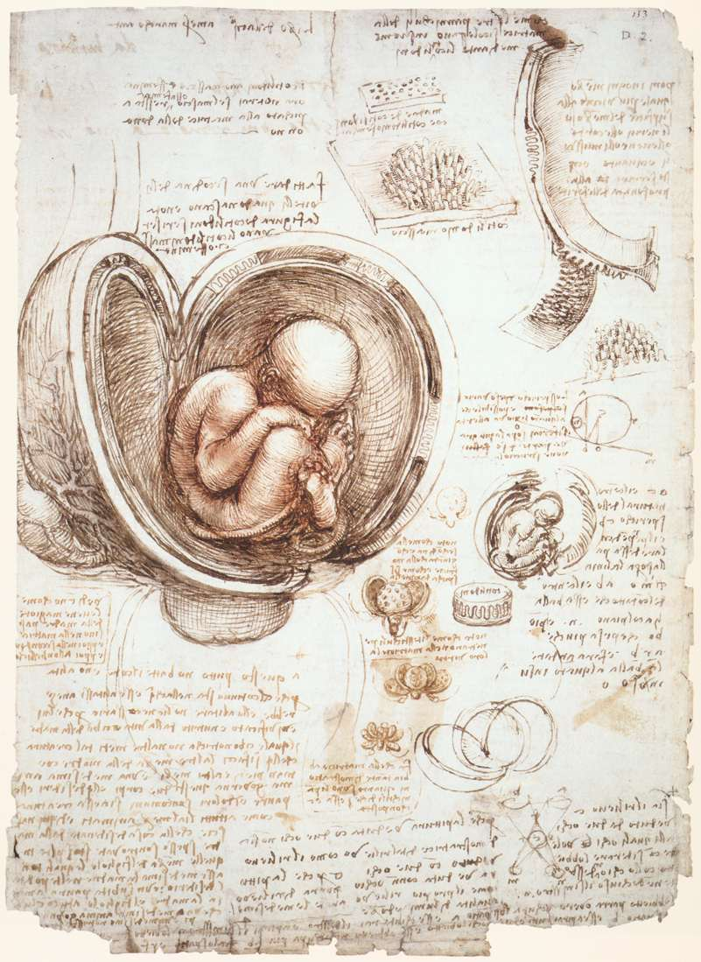
Leonardo, the Scientist (Biology): pages from his Notebook
An example of the humanist desire to unlock the secrets of nature.

Slide 19
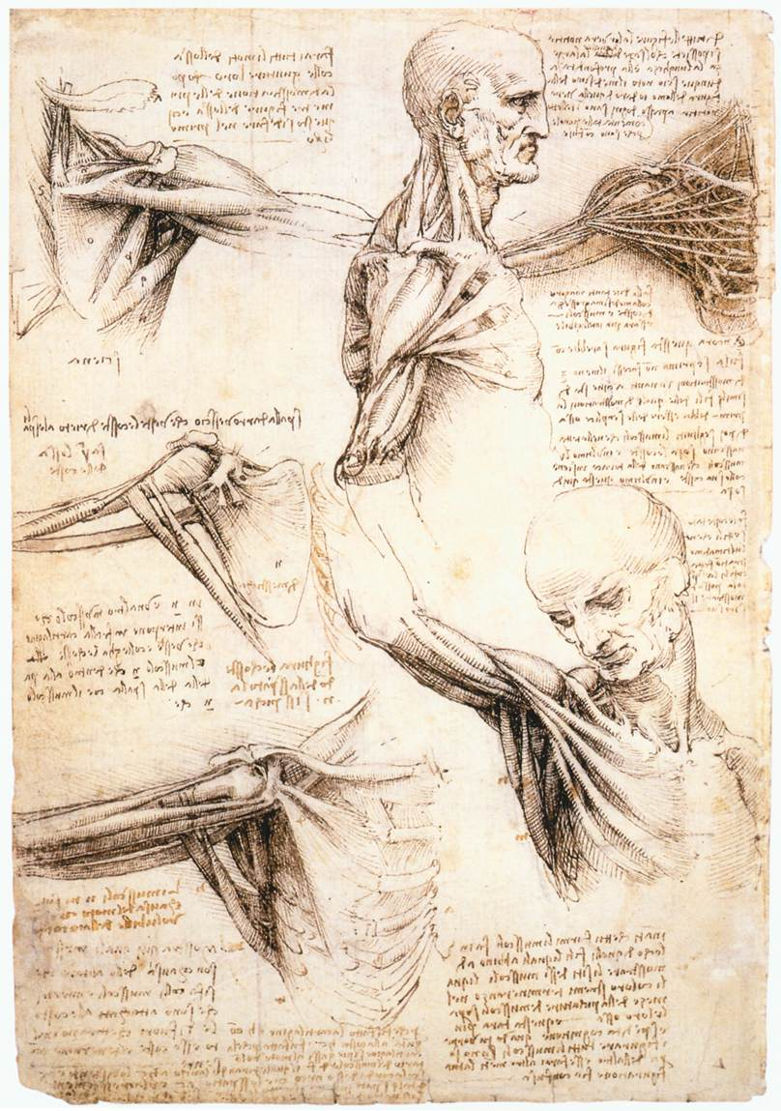
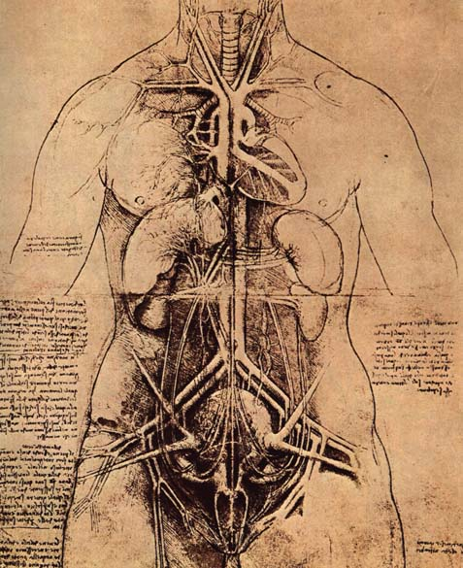
Leonardo, the Scientist (Anatomy): Pages from his Notebook

Slide 20
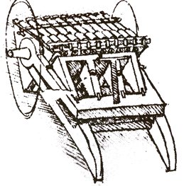
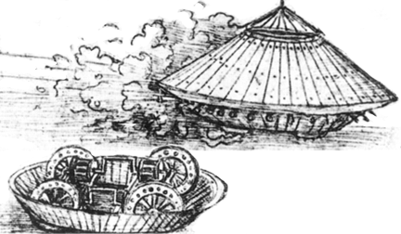
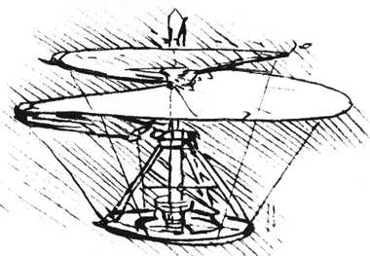
Leonardo, the Inventor: Pages from his Notebook

Slide 21
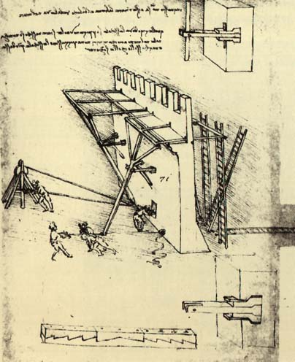
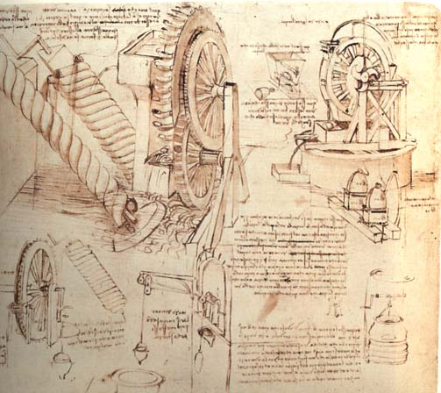
Leonardo, the Engineer: Pages from his Notebook
Studies of water-lifting devices.
A study of siege defenses.

Slide 22
2. Michelangelo Buonorrati
He represented the body in three dimensions of sculpture.

Slide 23
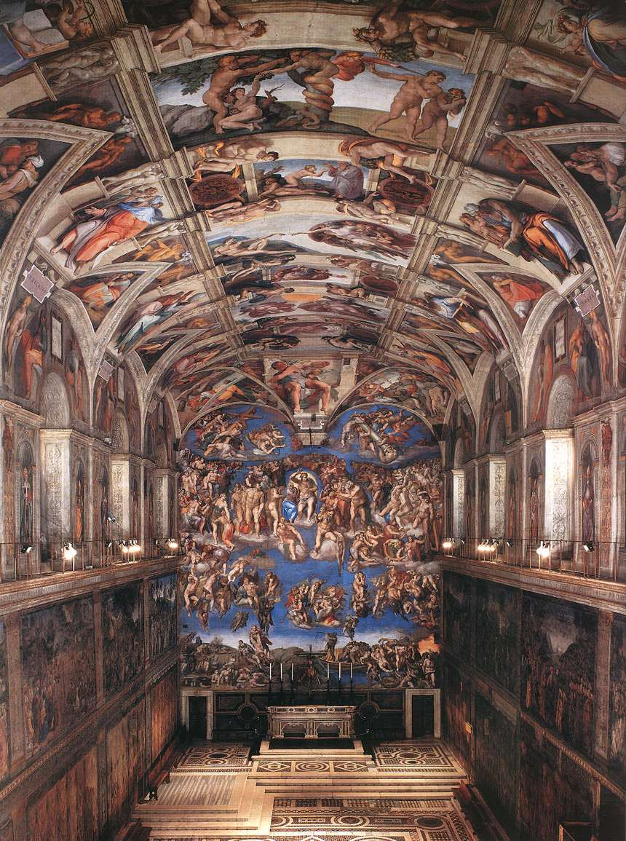
The Sistine Chapel Michelangelo Buonarroti 1508 - 1512

Slide 24
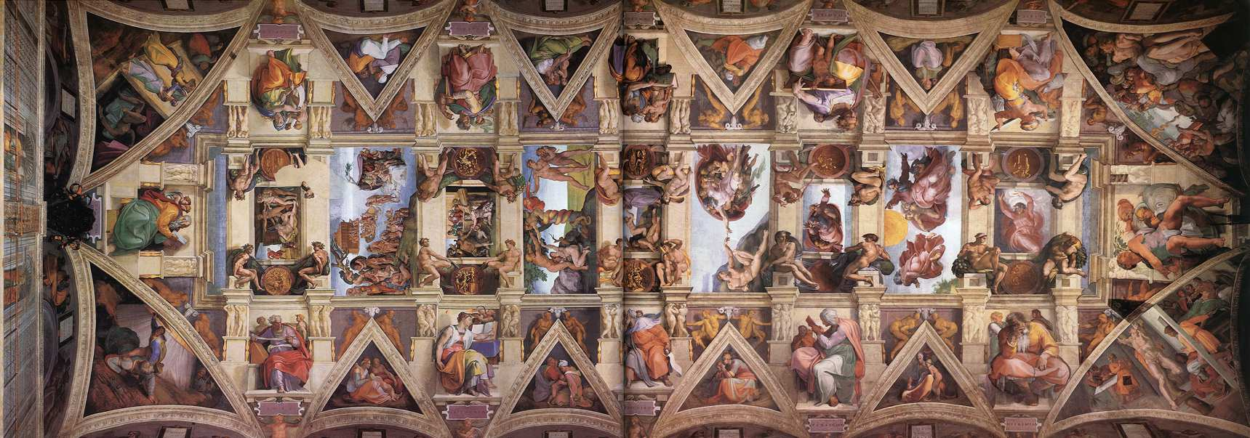
The Sistine Chapel’s Ceiling Michelangelo Buonarroti 1508 - 1512

Slide 25
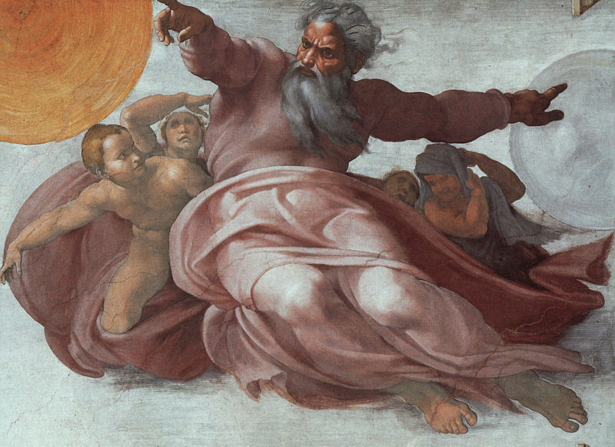
The Sistine Chapel Details
The Creation of the Heavens

Slide 26
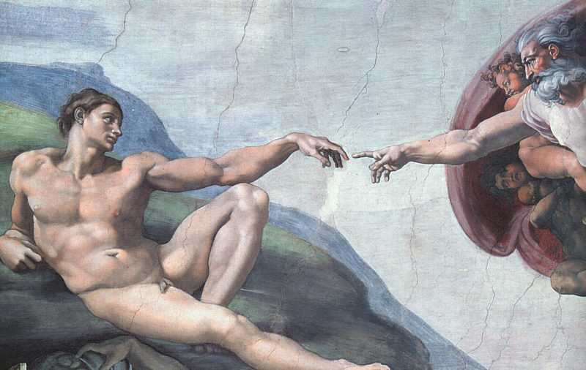
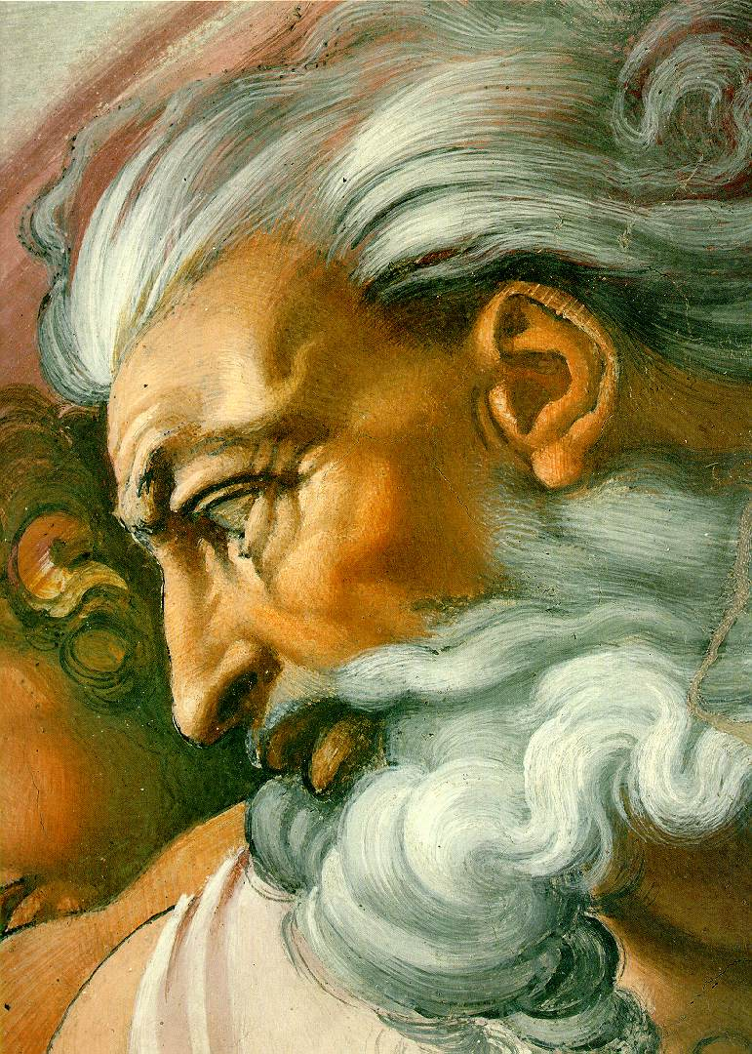
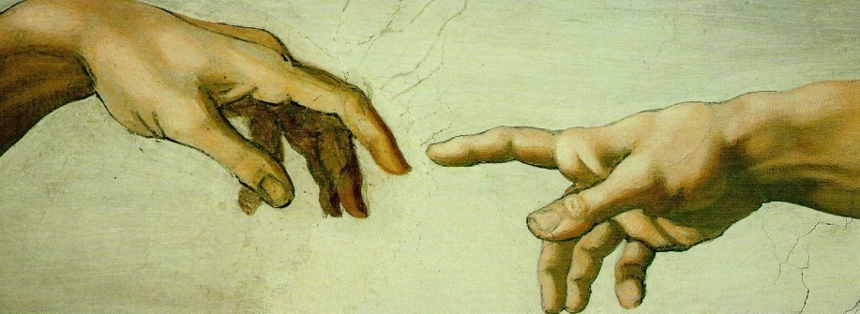
The Sistine Chapel Details
Creation of Man

Slide 27
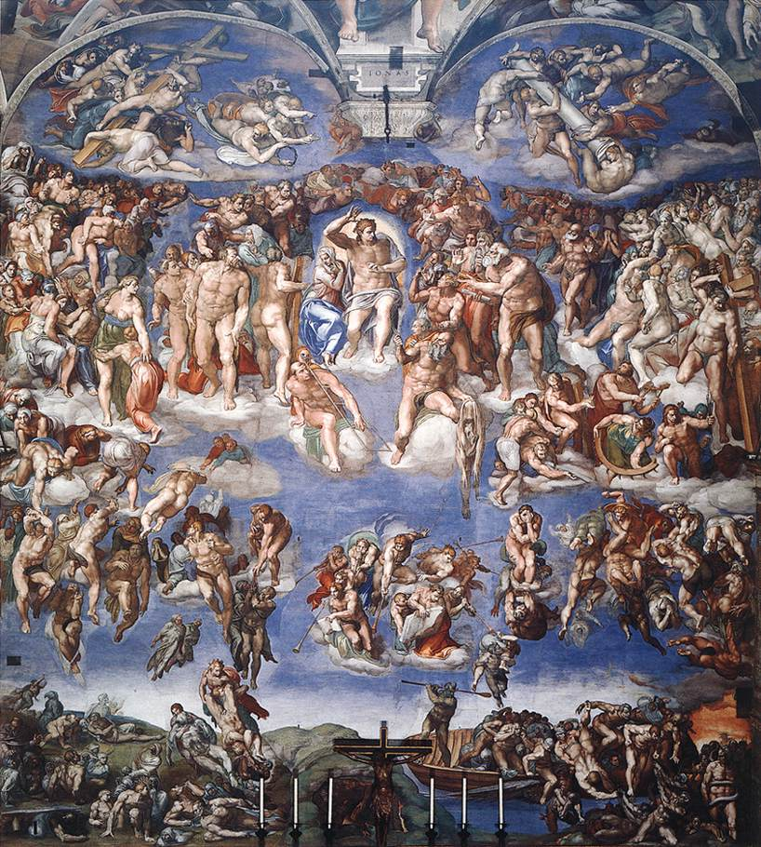
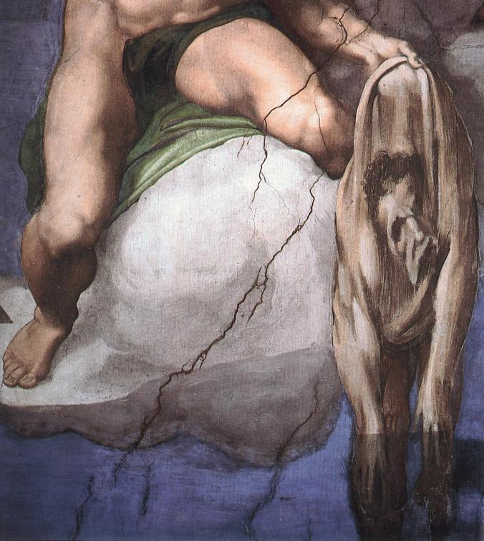
The Sistine Chapel Details
The Last Judgment

Slide 28
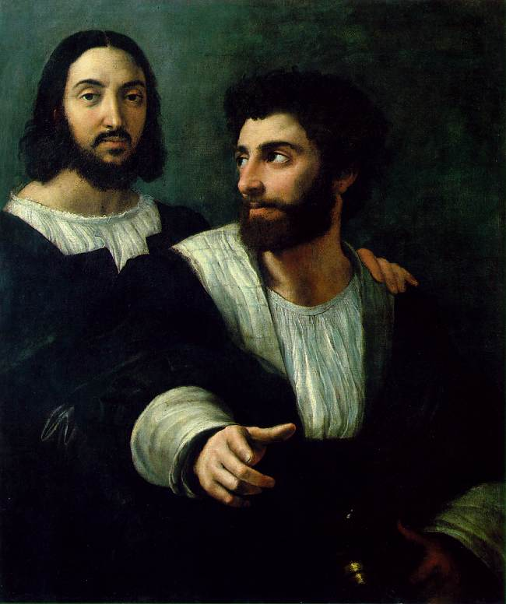
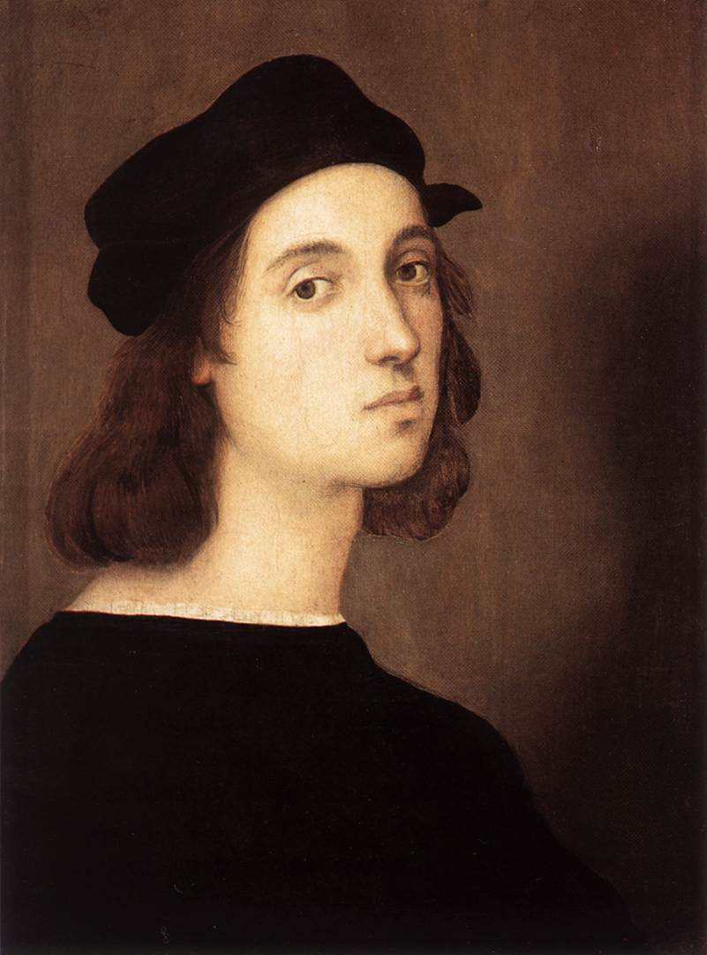
3. Raphael (1483-1520)
Self-Portrait, 1506
Portrait of the Artist with a Friend, 1518

Slide 29
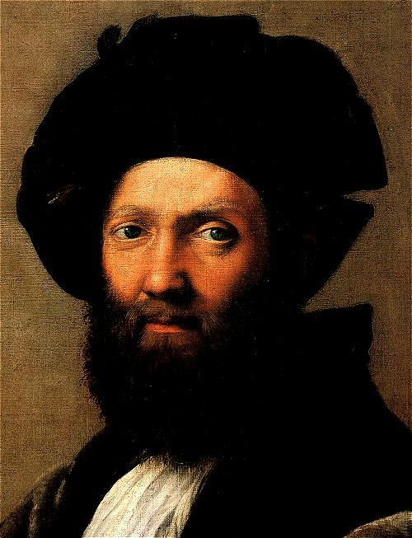
Baldassare Castiglione by Raphael, 1514-1515
Castiglione represented the humanist “gentleman” as a man of refinement and self-control.

Slide 30
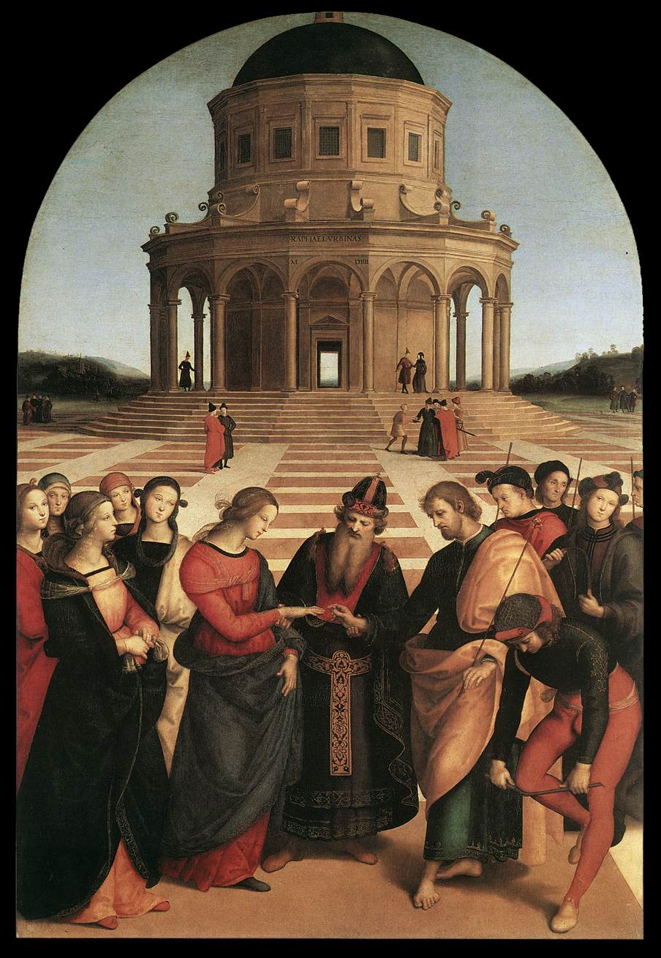
Perspective!
Betrothal of the Virgin
Raphael
1504

Slide 31
The School of Athens – Raphael, 1510 -11
One point perspective.
All of the important Greek philosophers and thinkers are included → all of the great personalities of the Seven Liberal Arts!
A great variety of poses.
Located in the papal apartments library.
Raphael worked on this commission simultaneously as Michelangelo was doing the Sistine Chapel.
No Christian themes here.

Slide 32
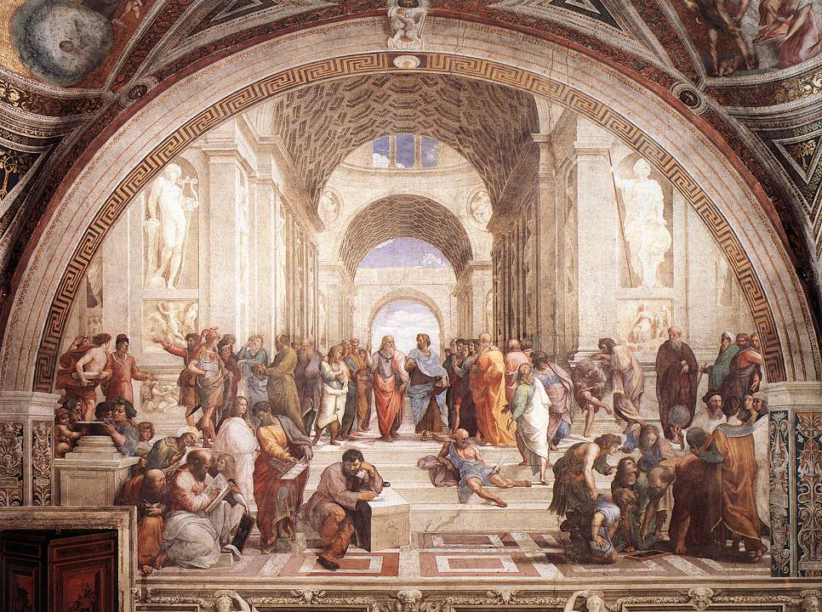
The School of Athens – Raphael, 1510 -11
Da Vinci
Raphael
Michelangelo

Slide 33
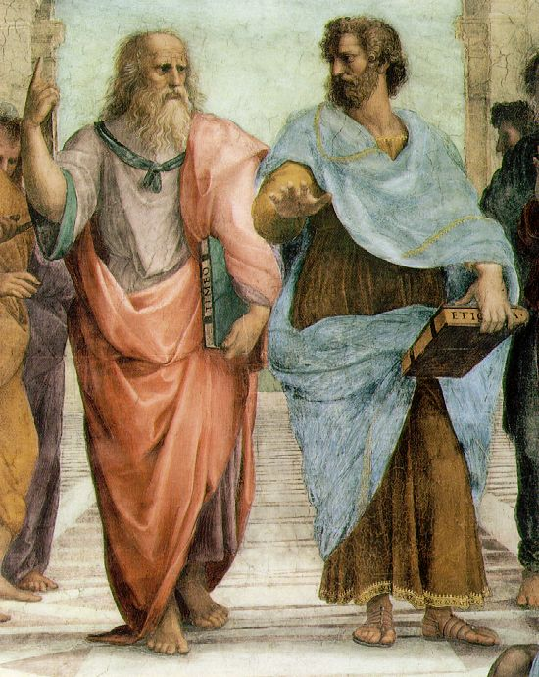
The School of Athens – Raphael, details
Plato: looks to the heavens [or the IDEAL realm].
Aristotle: looks to this earth [the here and now].

Slide 34
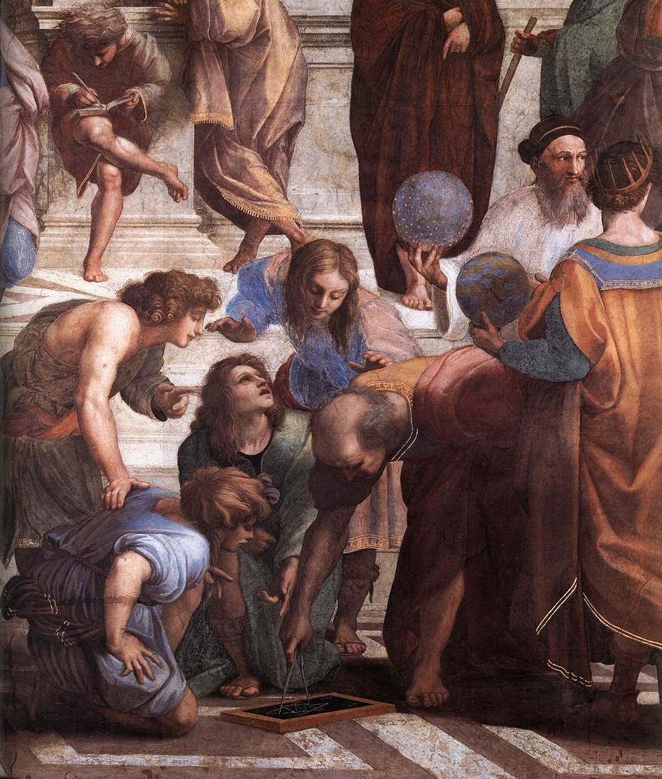
Zoroaster
Ptolemy
Euclid

