Slide 1
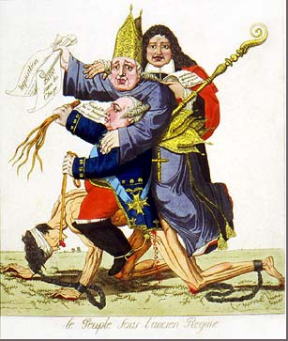
Warm-Up
Look at the picture to the right: (use pages 573-574 to answer following questions)
What do you see?
What does each person symbolize?
Why are they sitting on that poor man?
What is the cartoon telling us or portraying?
What comparisons can you make with this cartoon to the one in book on page 574?

Slide 2
The French Revolution

Slide 3
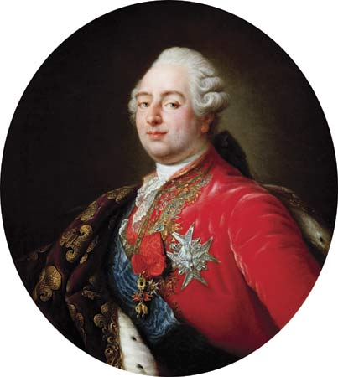
The Old Regime
There was great unrest in France
Caused by bad harvests, high price, and high taxes
Disturbing questions raised by Enlightenment thinkers such as Locke, Voltaire, and Rousseau
The social and political system of France was known as the Old Regime
Social classes were called estates
First Estate: Roman Catholic Church officials
Second Estate: rich nobles

Slide 4
The Old Regime
The Third Estate
Three different groups:
Bourgeoisie: merchants & artisans
Workers of France’s cities: cooks, servants, etc
Peasants
80% of France’s 26 million people
Usually about ½ their income was paid in taxes to nobles, tithes to the church, and agents of the king.
The Third Estate wanted CHANGE!!!

Slide 5
The Forces of Change
A Weak Leader
In May 1789, Louis XVI had a huge debt because he supported the Americans during their revolution.
Faced with the need to raise money he decided he tried to tax 2nd Estate
The Second Estate forced him to call a meeting of the Estates-General

Slide 6
Revolution Dawns
In this legislative body the two privileged estates could always outvote the 3rd estate
Delegates from the 3rd estate insisted that each delegate have a vote; in this way they would have as many delegates as the other two estates combined
The National Assembly
Third Estate wanted power and forced themselves to be called the National Assembly
Three days later, locked out of meeting room and forced themselves into an indoor tennis court and pledged to write a new constitution → Tennis Court Oath
Storming the Bastille
Rumors flew throughout Paris that troops were coming to massacre French citizens
On July 14th, Parisians stormed the Bastille, a Paris prison to find weapons and gunpowder
Now seen as a national holiday---similar to our July 4th

Slide 7
The Assembly Reforms France
The Rights of Man
In August, the National Assembly adopted a statement of ideals called the Declaration of the Rights of Man
Declaration of the Rights of Man: “men are born and remain free and equal in rights”
Equal justice, freedom of speech & religion
“Liberty, Equality, Fraternity”

Slide 8
Conflicting Goals Cause Divisions
A Limited Monarchy
The National Assembly created constitutional monarchy
The king was stripped of much of his authority and the Legislative Assembly had the power to create laws
Factions Split France
2 extremists: Emigres and sans-culottes
Emigres: hoped to restore Old Regime
Sans-culottes: wanted a greater voice in government

Slide 9
War and Extreme Measures
War with Austria
Although French radicals hoped to spread their revolution, European monarchs opposed the revolution
Austria and Prussia tried to put Louis back on the throne
They hoped that by helping Louis regain his position as an absolute monarch they would help preserve their own power
Legislative Assembly declares war back at Austria and Prussia

Slide 10
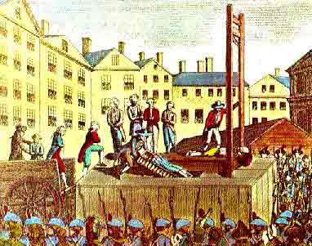
War and Extreme Measures
Radicals Execute the King
In summer of 1792, the French people imprisoned Louis and Marie Antoinette and their children
The most radical club was the Jacobin Club
Wanted to remove the king and establish a republic
Jean Paul Marat, one of the leaders hoped to rid France of the enemies of the Revolution
Jacobins tried Louis for treason and found him guilty and executed him to death
Guillotine
Thousands of French were beheaded by this machine

Slide 11
The Reign of Terror
Robespierre Assumes Control
Maximilien Robespierre gained control of Paris and France
He and his followers established “Republic of virtue” and wipe out all traces of French monarchy and nobility
Created the Committee of Public Safety to find enemies of the republic
Ruled a s a dictator through the Reign of Terror (July 1793-1794)
As many as 3,000 killed in Paris and 40,000 in France during Reign of Terror

Slide 12
End of Terror
Members of the National Convention knew they were not safe from Robespierre so they turned on him and executed him
Ending the Reign of Terror on July 28, 1794
They created a new type of government and constitution
Power in the hands of the upper-middle class
Legislative and executive body known as the Directory
Directory looked to Napoleon Bonaparte to command France’s armies

