Slide 1
Journal
Under your own American Dream paragraph you wrote yesterday write if you think the “American Dream” is still possibly today. Explain why or why not. Homework
  Sign Up for Remind
    @mrvolkmar
  Chapters 1 and 5 Reading (Online) – tba
  Unit 1 Quiz – tba
  Unit 1 HW and Test – tba

Slide 2
Unit 1
Intro to Civics and Government

Slide 3
What is Government?
The term government describes the means by which a society organizes itself and allocates authority in order to accomplish collective goals and provide benefits that the society as a whole needs.

Slide 4
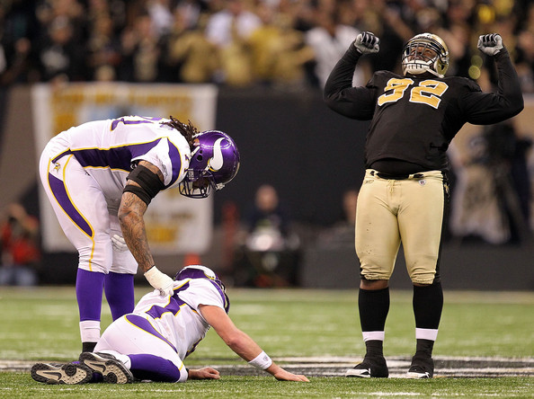
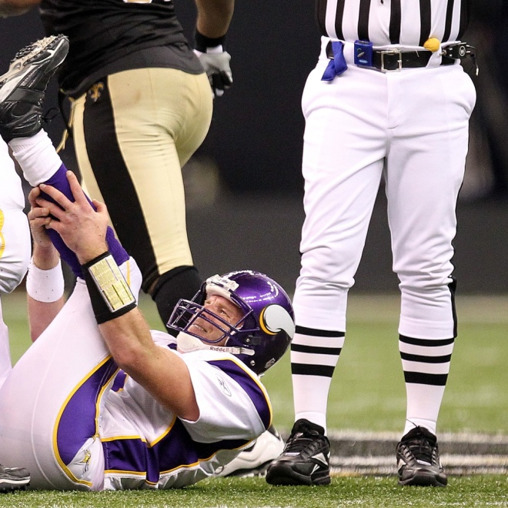
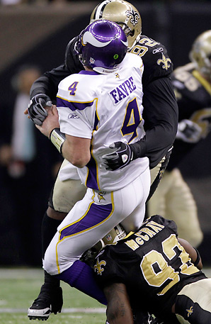
Why Do We Need Government?
The basic reason we need government is to establish rules
  Imagine playing a game (basketball, football, checkers) where there were NO rules

Slide 5
Four Basic Functions of Gov.
Keep Order → gov’t makes laws to prevent and settle arguments in society
Provide Security → gov’t protects people and their property
Provide Services → many things we need would be nearly impossible w/out coordination
Guiding the Community → gov’t helps society decide what is important
Notes:
Keep Order:
Federal/National → Congress passes a law banning assault weapons
State → the drinking age in NC is 21
Local/City → when walking a dog in Cary, it must be on a leash
Provide Security:
Federal/National → U.S. Army, Marine Corps, Air Force, Navy, Coast Guard, Border Patrol, etc.
State → State Bureau of Investigation, Highway Patrol, NC National Guard, etc.
Local/City → Cary Police, Wake County Sheriff Department, etc.
Provide Services:
Federal/National → Interstate Highway System, Social Security, etc.
State → NC Department of Transportation salts roads during ice storms
Local/City → local garbage pickup, school systems, etc.
Guiding the Community:
Federal/National → the president makes and Congress approves the national budget (over $4 trillion)
State → Gov. Bev Perdue places emphasis on state trooper safety when driving
Local/City → Wake County School Board votes to move toward community-based schools

Slide 6
The Need for Government
Thomas Hobbes(Think back to 9th Grade)
  Life without government would “solitary, poor, nasty, brutish and short”
  Believed that human beings naturally compete for territory, resources, and power.
  Believed people are equal
Leviathan (1651)
Notes:
Musical chairs example

Slide 7
So what type of government does the U.S. have?
Representative Democracy!
“I pledge allegiance to the flag of the United States of America, and to the republic for which it stands…”

Slide 8
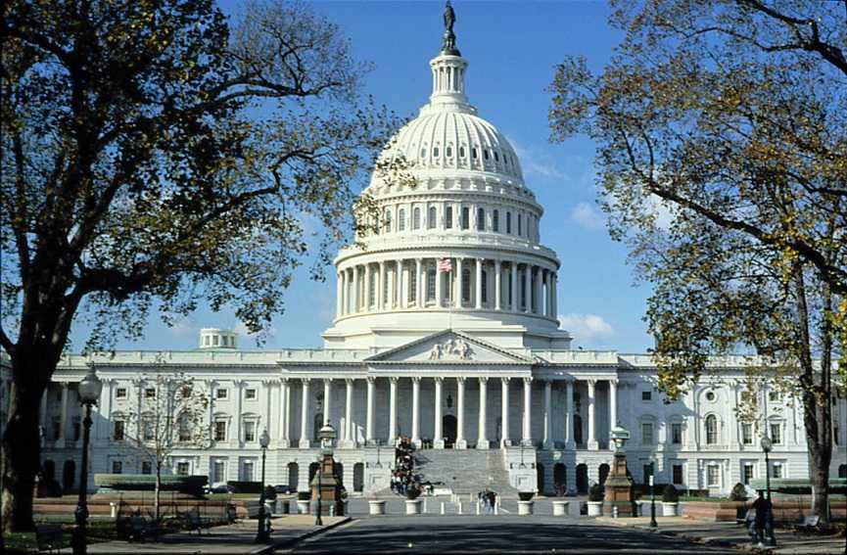
Levels of Government
National: The government of an entire country. In the USA, the national government is also called the Federal Government.

Slide 9
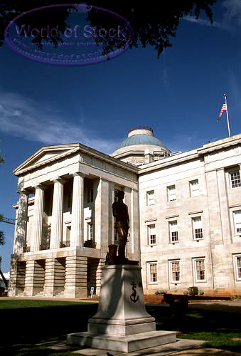
Levels of Government
State: The government of a specific region or area of a country; in the USA we call these states. Other countries call them provinces, prefects, regions, etc.

Slide 10
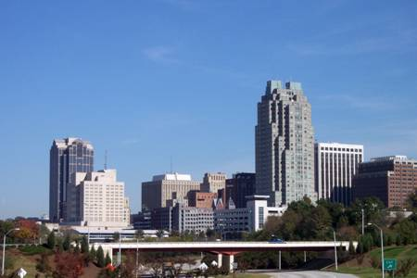
Levels of Government
Local: The government of a small area, usually a county, city, or town.

Slide 11
Types of Government
Democracy: Government by the citizens/people
-Direct Democracy: All citizens have the chance to vote for any law or action. (Town Hall Meeting)
- Representative Democracy: citizens elect people to represent them in making government decisions.

Slide 12
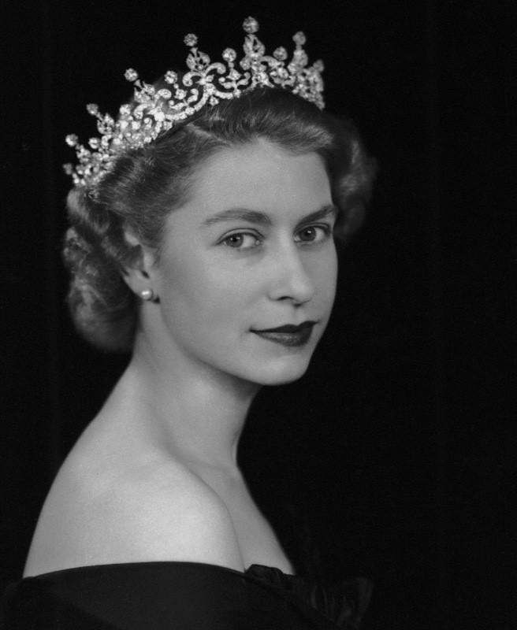
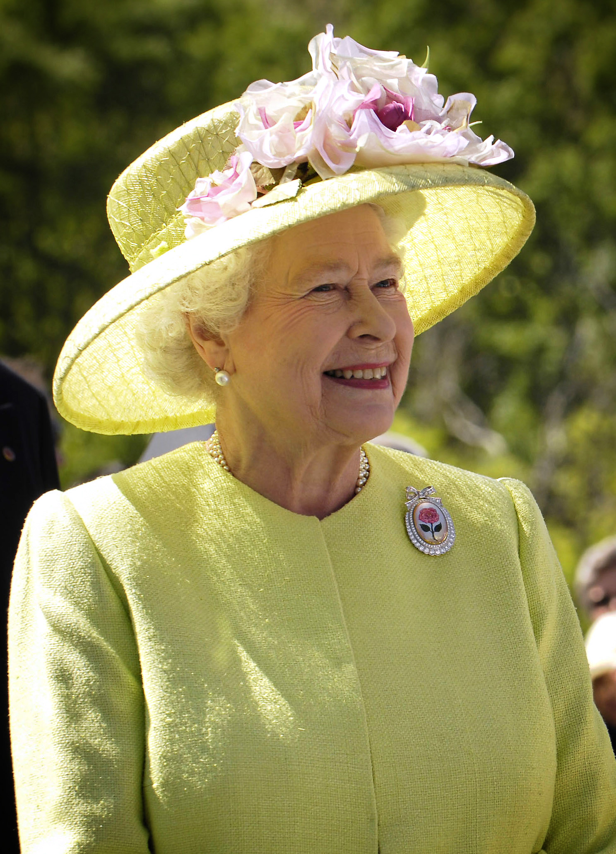
Monarchy
a King or Queen controls the entire government and makes all decisions
  Constitutional monarchy: the King or Queen shares power with a legislative body, often called the parliament
Notes:
The Queen is Head of State of the UK and 15 other Commonwealth realms. The elder daughter of King George VI and Queen Elizabeth, she was born in 1926 and became Queen at the age of 25, and has reigned through more than five decades of enormous social change and development. The Queen is married to Prince Philip, Duke of Edinburgh and has four children and eight grandchildren.

Slide 13
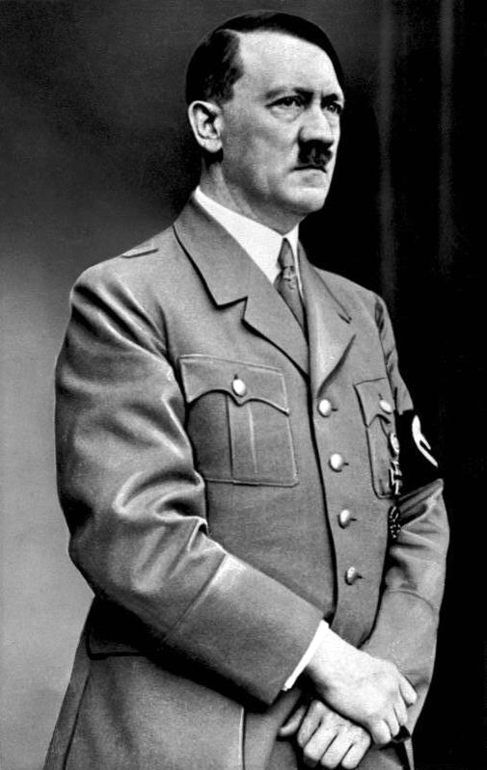
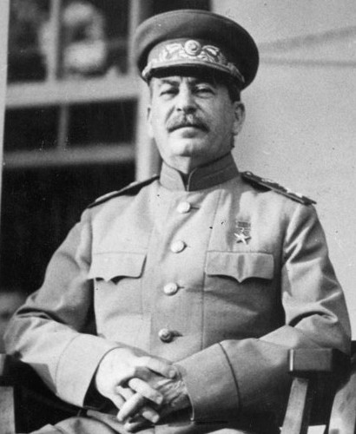
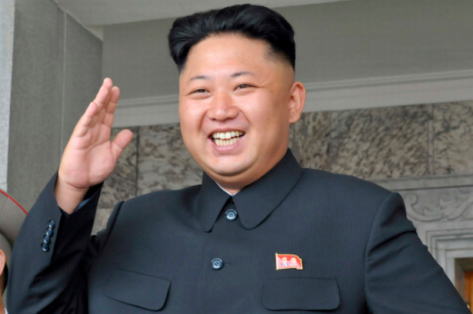
Dictatorship/Autocracy/Totalitarian State:
A single ruler completely controls the government and all decision-making. This person usually came to power by military force.
Notes:
North Korea
Germany
Russia
Japan

Slide 14
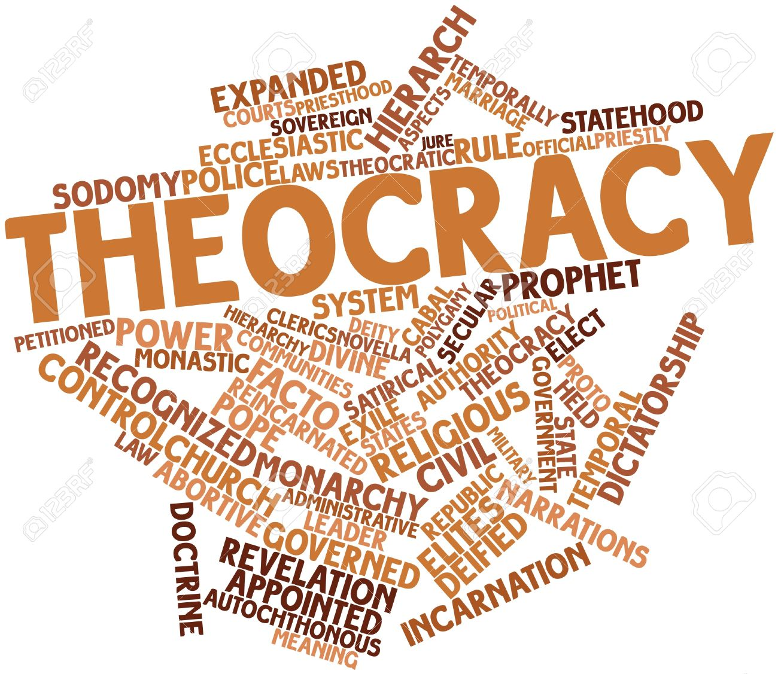
Theocracy
Government is controlled by religious leaders
Notes:
In a theocracy, God (or Gods, depending on the religion) is recognized as the sole head of the government.
The modern Islamic Republic of Iran became a theocracy, dominated by the laws and clerics of the Shi'a sect of Islam, in December 1979. According to the laws set in place by the 1979 Iranian constitution, God is recognized as the sole head of both state and religion in Iran, and he is embodied by his representative on Earth, the Ayatollah.

Slide 15
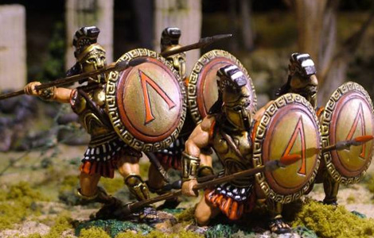
Oligarchy
Government of the few; often a small group of wealthy nobles/aristocrats

Slide 16
Does anyone know what the three branches of Government are?

Slide 17
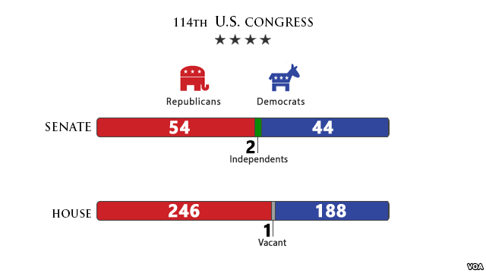
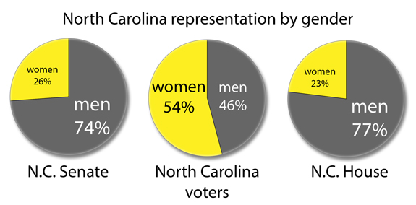
Branches of Government
Legislative: Makes laws
-Ex: US Congress, NC General Assembly

Slide 18
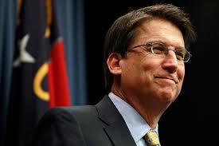
Branches of Government
Executive: Enforces laws
- President Donald Trump, Governor Pat McCrory

Slide 19
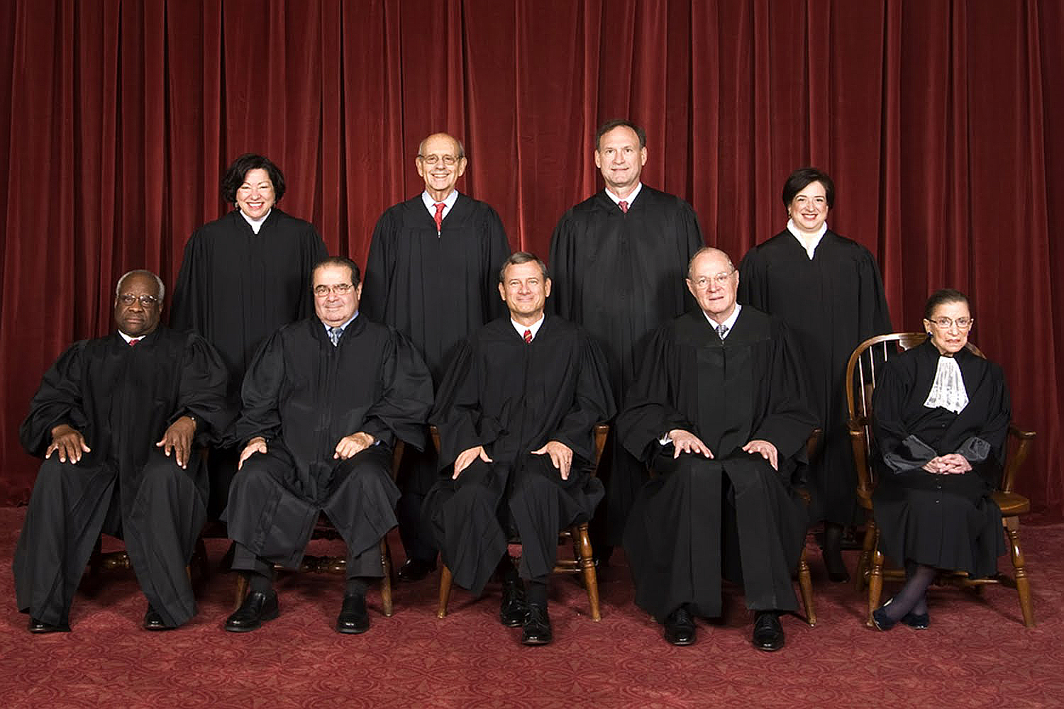
Branches of Government
Judicial:
Interprets laws
- Courts
Pictured: U.S.
Supreme Court
Can you name them?
Notes:
Creepy Clarence Thomas, Antonin “Fat Tony” Scalia, John Edwards… I mean, Roberts, Anthony “Not one of those Kennedys” Kennedy, RUTH Bader Ginsberg AKA Notorious RBG
Sultry Sonia Sotomayor, Stephen “The Ice Cream Man” Breyer, Samuel “Strict Contructionist” Alito, Elana “Karate Chop” Kagan

Slide 20
Does anyone remember who came up with separation of powers?
Notes:
Think back to 9th Grade World History Class. Baron De Montesqueiu

Slide 21
***COPY DOWN THE FOLLOWING IN YOUR NOTES!***
What Makes a Democratic Republic?
5 Principles of Democracy
  Rule of Law
  Limited Government
  Consent of the Governed
  Individual Rights
  Representative Government

Slide 22
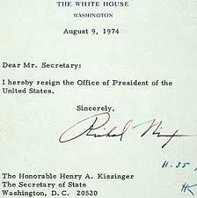
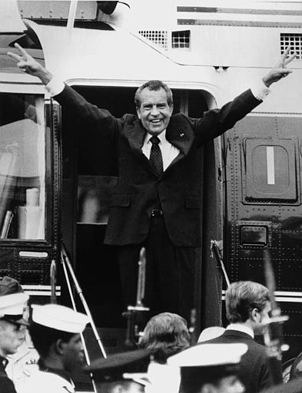
Rule of Law
The law applies to everyone, even our leaders!
  President Nixon was forced to resign when he lied to prosecutors about his involvement in the Watergate scandal
  Illinois Governor Rod Blagioivich was found guilty of lying to the FBI about trading a Senate seat for money

Slide 23
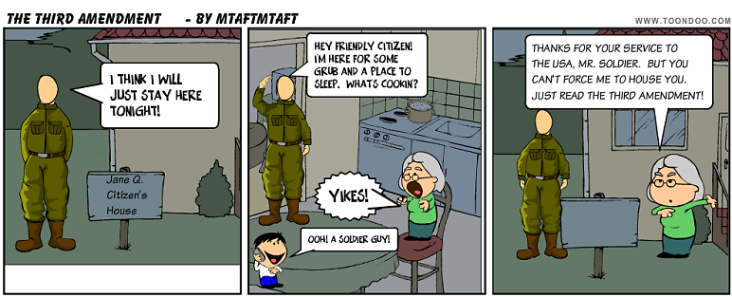
Limited Government
Government can only do things the people give it power to do!
  The government cannot force you to let soldiers live in your house during times of peace.

Slide 24
Consent of the Governed
The source of government’s power is the people!
  The people are the battery for government! We are the government’s Energizer Bunnies! We elect them!
  Abraham Lincoln said we have a “government of the people, by the people, and for the people.” Notice a common theme?
  Us!

Slide 25
Individual Rights
The government’s main job is to protect our rights!
  Americans have the right to free speech, to practice their own religion, to keep and bear arms, and have a fair trial.
  We don’t have the right to do anything we want though!
  “The right to swing my fist ends at another man’s nose.” – Oliver Wendell Holmes

Slide 26
Representative Government
People elect their leaders to act on their behalf!
  America is a republic because we have free and fair elections!
  You can’t please everyone all the time, so our gov’t operates on majority rule

Slide 27
Citizenship
Defined: A citizen is a community member entitled to certain rights and required to perform select duties.
Notes:
What does it mean to be a Global citizen? Digital Citizen?

Slide 28
How does one become a citizen?
By birth
Citizenship is automatically granted to anyone born in 50 states, D.C., American territories, or overseas military base.
Note: Can claim citizenship if born outside U.S. if
-both parents are American or
-one parent is a citizen who has lived in America.

Slide 29
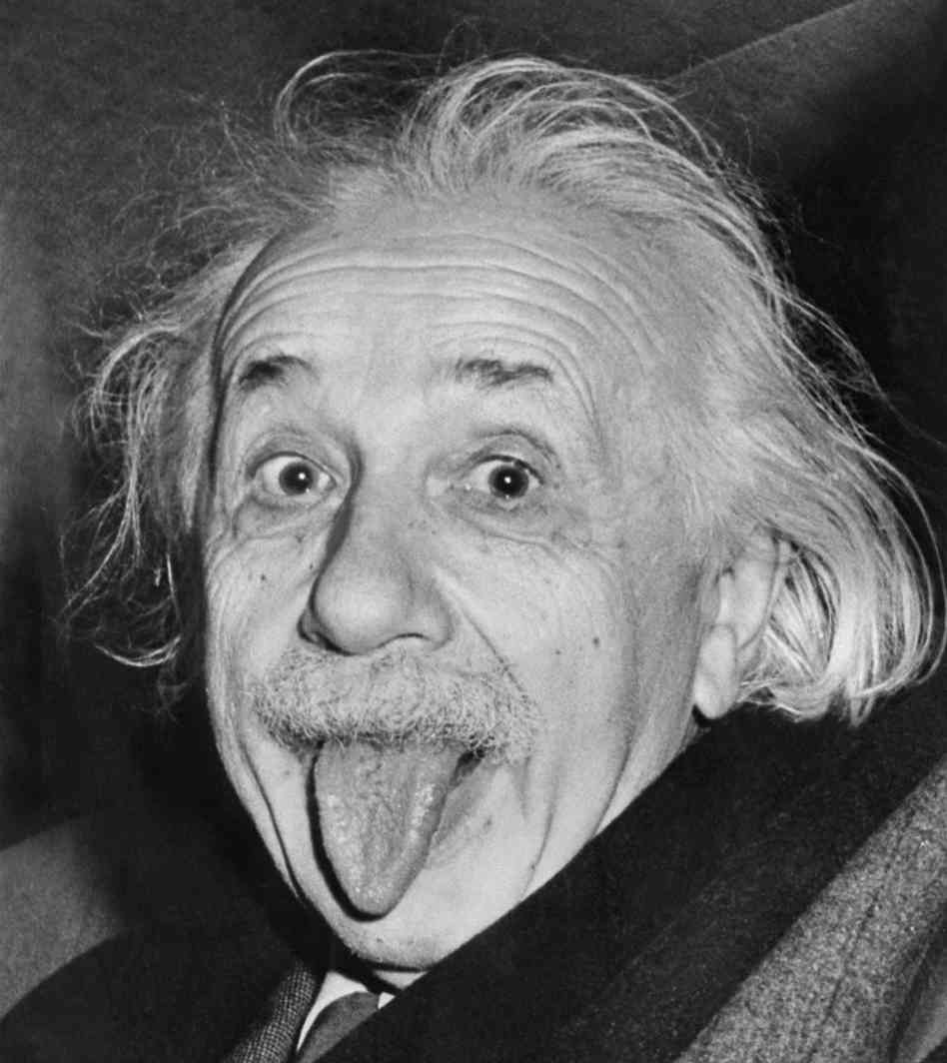
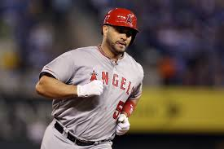
How does one become a citizen?
By naturalization
Sign Declaration of Intention
Live in U.S. for five years
(three if married to citizen)
Notes:
Einstein and Pujols

Slide 30
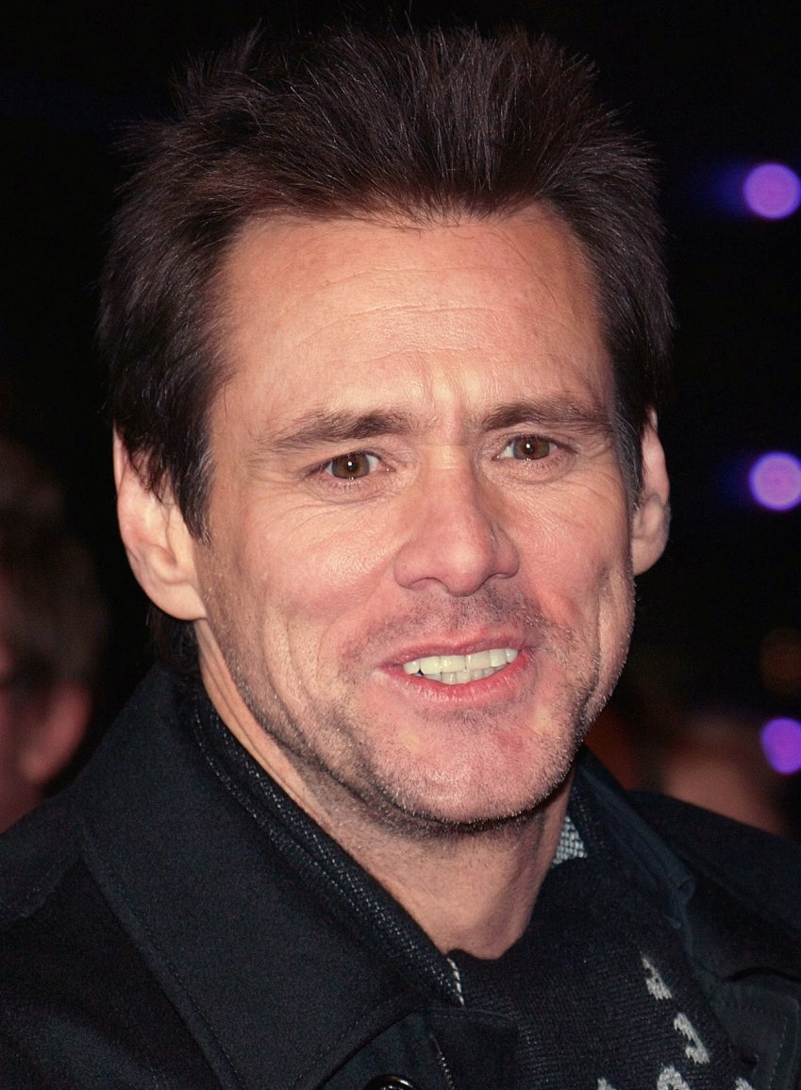
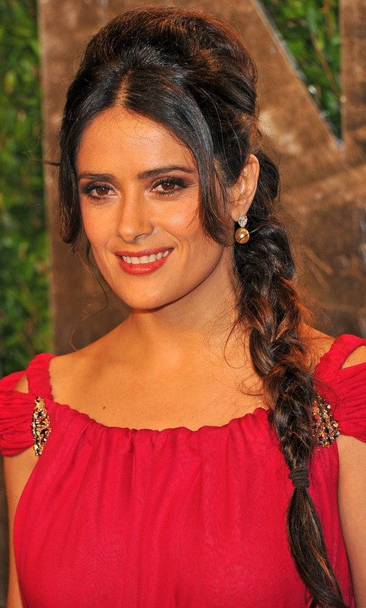

How does one become a citizen?
By naturalization
3) If 18 and have lived in state
where naturalization saught,
candidate may file application.
4) After paperwork reviewed by
U.S. Citizenship and Immigration
Services, USCIS interviews alien.
Notes:
Salma Hayek and De Terminator, Jim Carrey

Slide 31

How does one become a citizen?
By naturalization
4) Continued
Interviewer checks for “good
moral character”
5) Exams administered on English
and history/civics
Notes:
Sigfreid and Roy

Slide 32
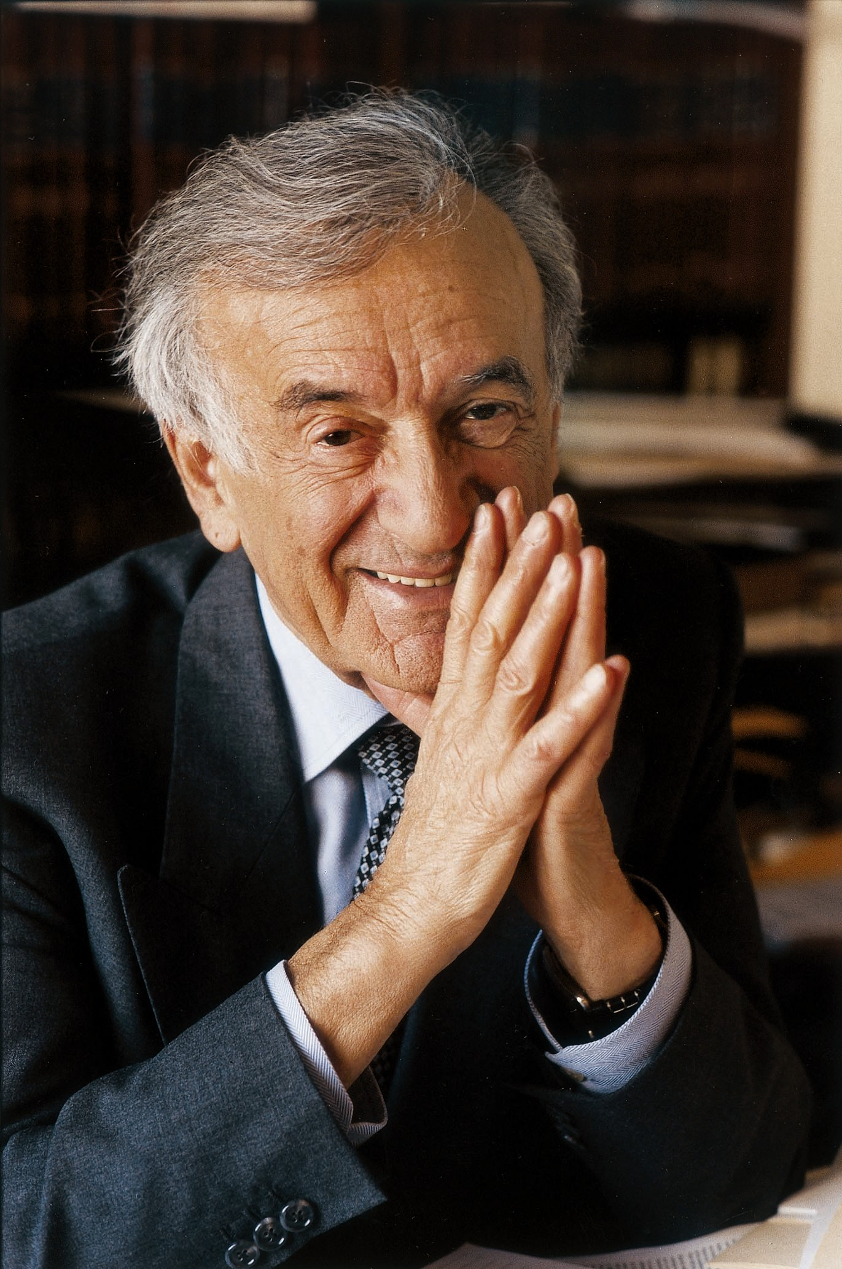
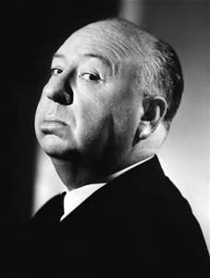
How does one become a citizen?
By naturalization
6) UCCIS makes
a decison to grant or
deny citizenship.
Notes:
Elie Wiesel and Alfred Hitchcock

Slide 33
Volunteerism*
The practice of offering your time and services to others without payment.

Slide 34
Citizenship Test*
mrsichakpchs.weebly.com

Slide 35
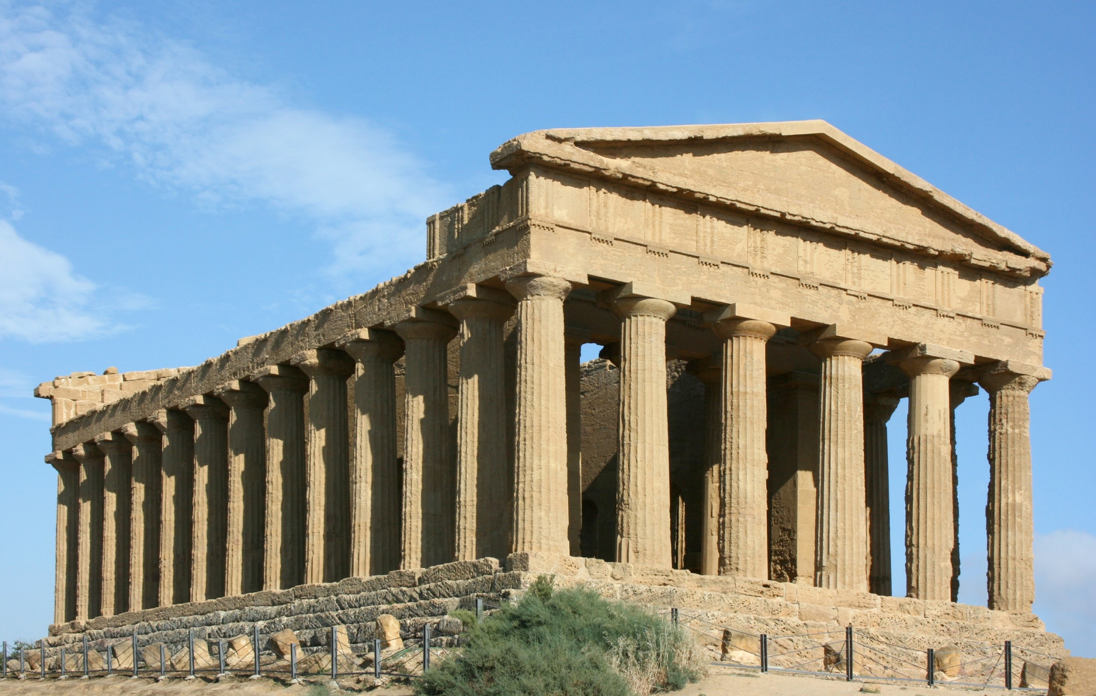
What is Civics?
Defined: the study of rights and duties of a citizen.
Greece and Rome
Notes:
three key terms

Slide 36
Rights
What are rights?
Rights are rules about what is allowed or owed to people. Could be legal, social, or ethical.
Examples of a legal right? Social right? Ethical right?

Slide 37
Duties
Defined: Things we MUST do.
Failure to perform duties may result in legal penalties.(Fines, jail, etc)
Examples?

Slide 38

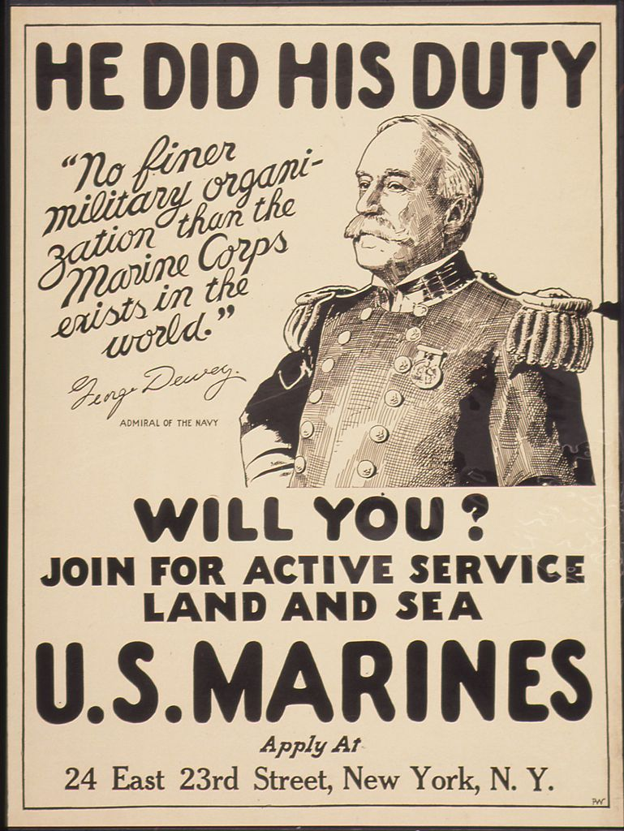
Duties
Obey Laws
Pay Taxes
Defend the Nation
  Draft
Serve in Court
Attend School

Slide 39
Civic Responsibilities
Defined: Obligations we fulfill voluntarily (Things we SHOULD do)
Examples?

Slide 40
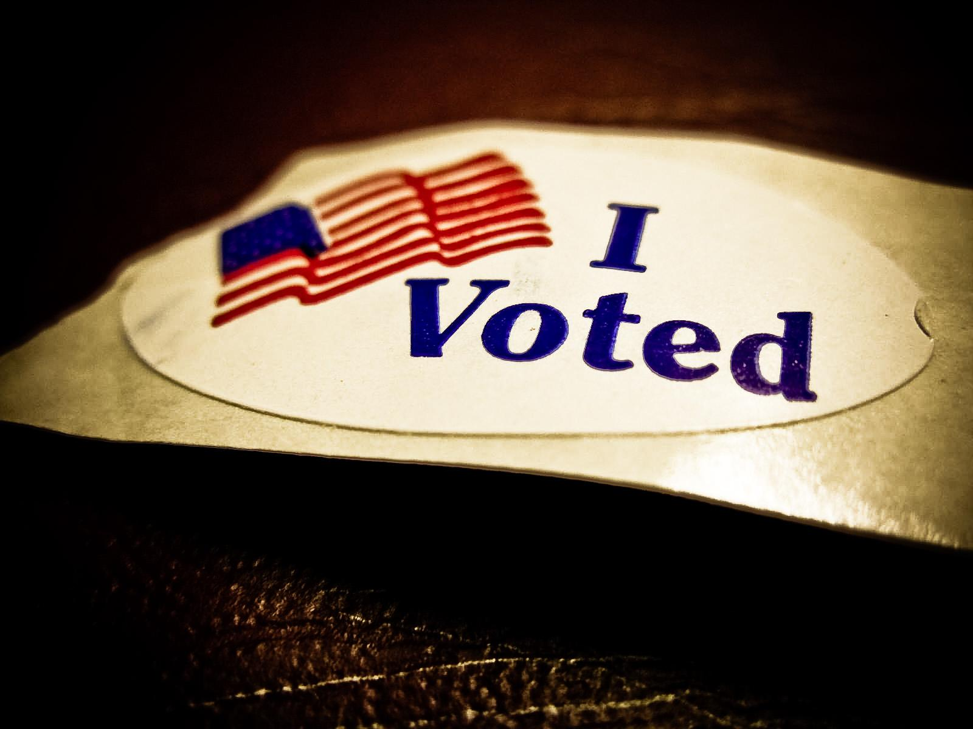
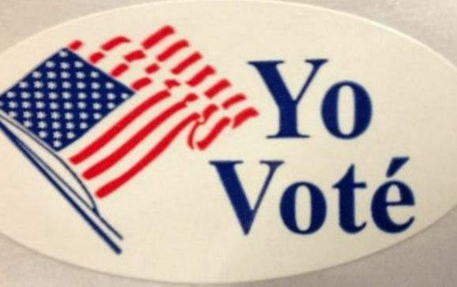
Civics Responsibilities
Be informed
Speak up and Vote
Respect others’ rights
  Tolerance
Respect diversity
Contribute to the common good

Slide 41
Who Can Explain the Following?
Dream Act
Birthright Citizenship

Slide 42
The Steps of Naturalization (Academic)
Your goal is to create a three-fold pamphlet outlining the steps necessary for an alien to become a naturalized citizen of the United States. Your pamphlet must include the following:
  An illustrated, colored title page
  Inside (page 1): What is a citizen? Then, a brief explanation of rights granted to legal aliens, and rights denied to legal aliens.
  Inside (page 2) A brief introduction to the process of naturalization. (What is it, why do we do it?)
  Inside (page 3) The Steps of Naturalization, with at least six specific steps involved in becoming a citizen; provide explanations of each step.
  Definitions (underlined or highlighted) of the following terms: naturalization; aliens; immigrants; Immigration Act of 1990 (may be located throughout pamphlet and/or in a separate glossary)
  At least two colored illustrations, not including the title page.
  **Assignment will be graded based on the quality/completeness of information included, and will be based on the four-point scale. In order to receive a “4” work must be neat and organized, and must display some creativity in formatting.

Slide 43
Immigration and Naturalization Activities (Honors):
Read the information found on pages 19 through 23 in your Civics textbook. (1.3) Then, using what you’ve read, write a brief (appx 1/2 page) foreword to an upcoming edition of a history study manual for aliens studying to become naturalized citizens. This foreword should help these soon-to-be citizens feel more comfortable about becoming part of the citizenry of the United States. (Be sure to include historical information / facts about past waves of immigration, who has come to the US throughout history, and briefly mention the process they will go through to become citizens. Focus on the history!)
Create an infographic which lists and explains each of the major steps required to become a US Citizen. Highlight/bold/underline any major vocabulary terms which show up in the chart! For each step you should include an icon (image, picture) that represents the action.

