Slide 1
Journal
What obligations and qualities of a good U.S. citizen?
Homework
Sign Up for Remind
@fallcivic
Chapters 1 and 5 Reading (Online) – Monday – 2/3
Unit 1 Quiz – tba
Unit 1 HW and Test – tba

Slide 2
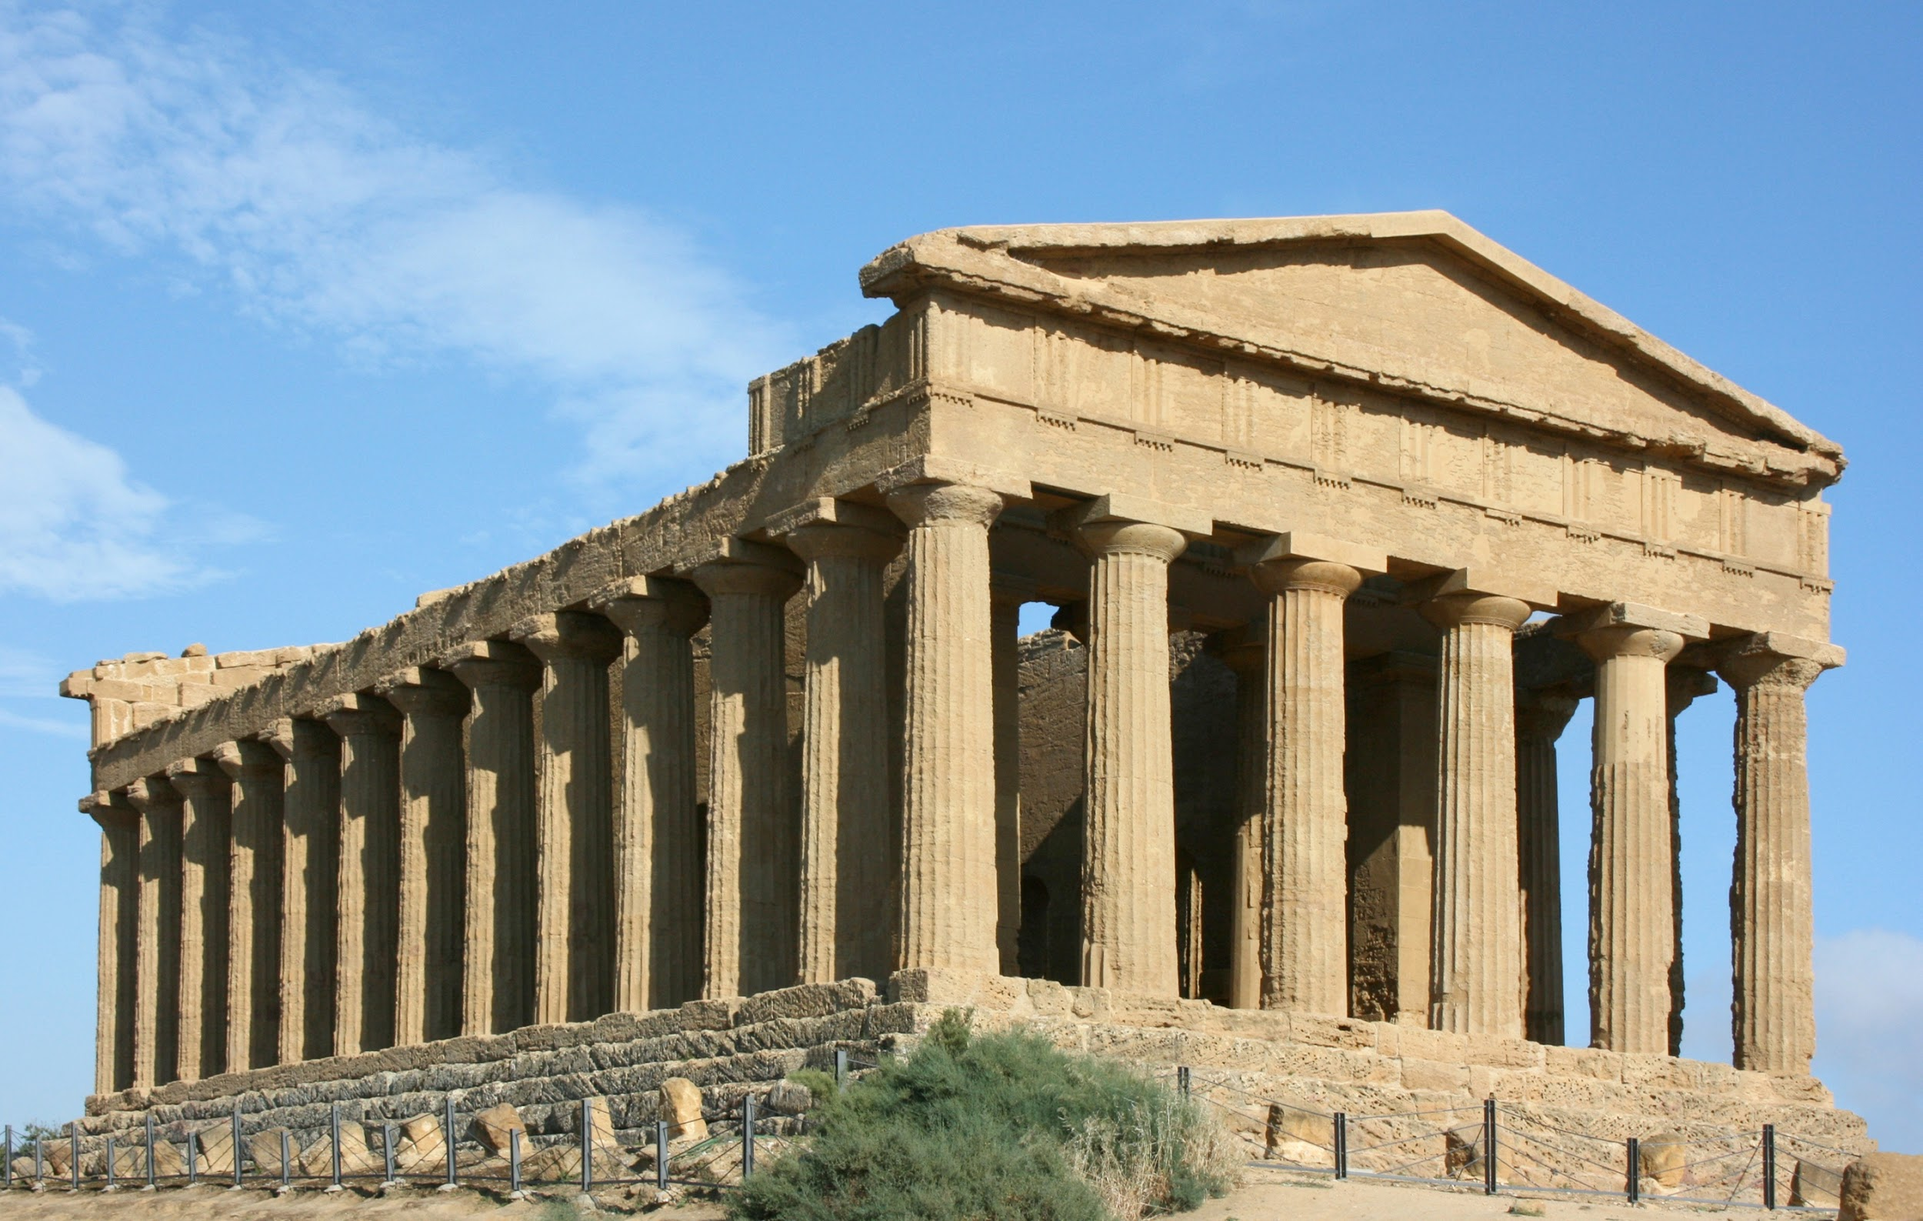
What is Civics?
Defined: the study of rights and duties of a citizen.
Greece and Rome
Notes:
three key terms

Slide 3
Rights, Duties, and Responsibilities

Slide 4
What does it mean to be a citizen?
Holding the “office of citizen” means you are entitled to all the rights guaranteed to Americans by the Constitution.
Who protects these rights?
The courts
American rights are based on a common set of values: justice, equality, freedom

Slide 5
Citizens’ Rights, Duties, and Responsibilities
Rights
Duties
Responsibilities
Examples
Examples
Examples

Slide 6
The Rights of Citizens…
…are guaranteed by the Constitution.
Examples
To vote and hold elected office
To say what you think in speech and writing
To practice your own religion
To have a fair trial
To be protected while in other countries

Slide 7
The Duties of Citizens…
…are required by law.
Examples
To obey society’s laws
To defend the nation against threats to peace and security (men must register for the draft at age 18)
To serve on a jury or as a witness in court
To pay taxes
To go to school

Slide 9
The Responsibilities of Citizens…
…are expected by society but completely voluntary.
Examples
To contribute to the common good
To learn about issues and take part in government (be informed and vote!)
To help candidates with their campaigns
To influence government by expressing opinions
To improve our communities & respect diversity (tolerance)

Slide 10
Who Can Explain the Following?
Dream Act
Birthright Citizenship

