Slide 1
Warm Up:
Unit 2: The Middle Ages Day 1
Objective:
Explain what factors led to the Middle Ages/development of feudalism.
Question:
If our American government disappeared today, how would our lives be different tomorrow?
Important Dates:

Slide 2
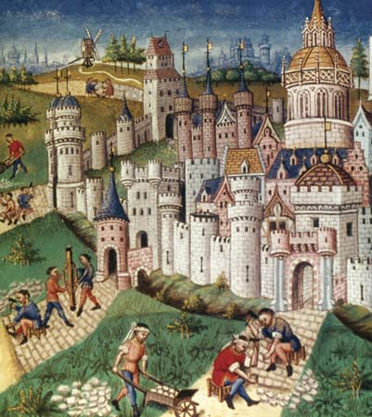
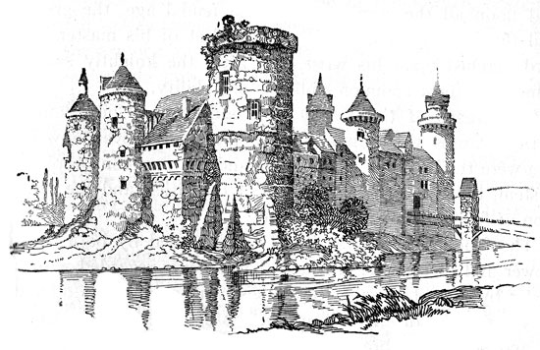
Unit 2: The Middle Ages Day 1
The Middle Ages

Slide 3
Causes/Effects of the Middle Ages
The Middle Ages: What is it?
Time period that existed between the Roman Empire and the Renaissance.
Other names: The Dark Ages or medieval period.
Often seen as a very bleak and dangerous period

Slide 4
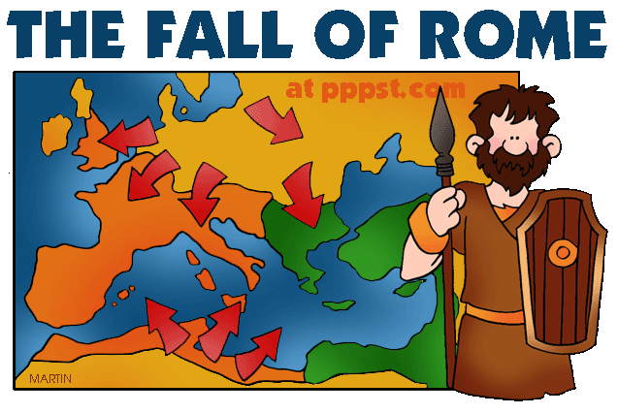
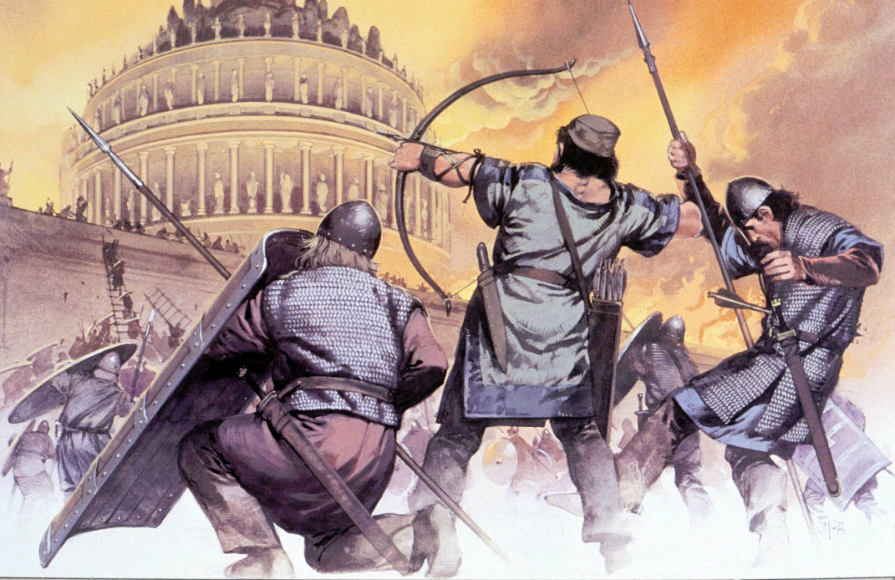
Fall of Rome

Slide 5
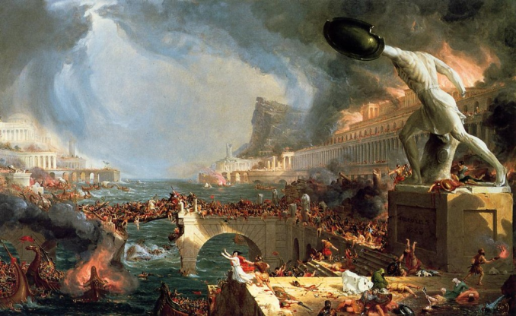
Causes/Effects of the Middle Ages
Causes of the Middle Ages
Fall of Rome
Invasions
Disruption of Trade: Merchant trade collapsed and Europe’s economic centers were destroyed. Money also became scarce.
Downfall of cities: Cities were abandoned as centers of administration.

Slide 6
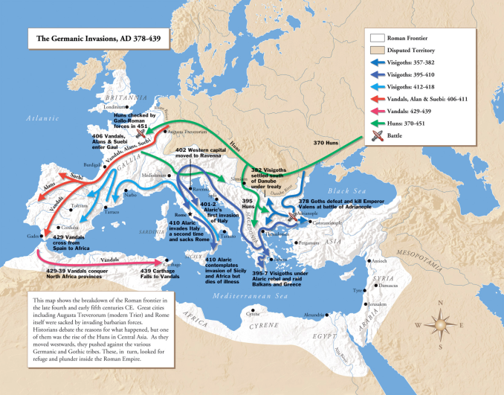
Causes/Effects of the Middle Ages
Invasions
Downfall of cities: Cities were abandoned as centers of administration
Decline of learning: Germanic invaders could not read or write. Learning became less important as people moved to rural areas.
Loss of a common language: Latin changed as Germanic people mixed with Roman population.

Slide 7
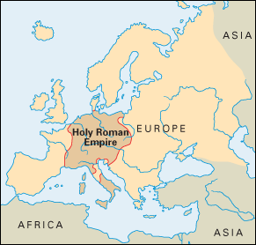
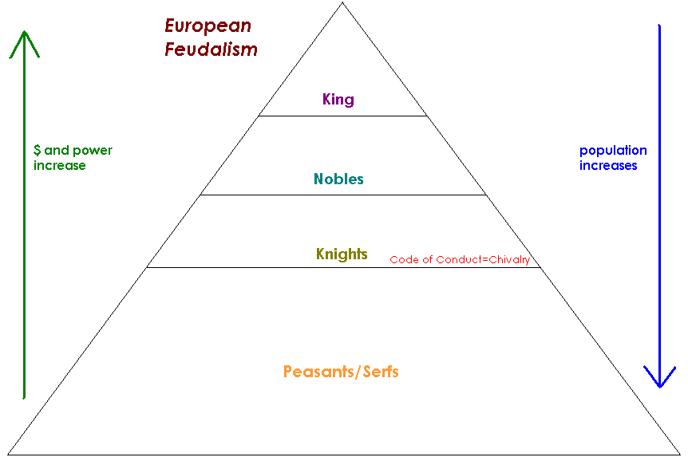
Causes/Effects of the Middle Ages
Effects of the Middle Ages
New Germanic Kingdoms Emerge (Holy Roman Empire)
Rise of the feudal system in Europe

Slide 8
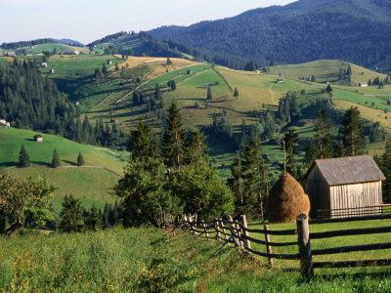
Causes/Effects of the Middle Ages
Effects of the Middle Ages
The power of the Christian Church (Catholic) grows rapidly
Europe became rural (safer?)
No major emphasis on learning

Slide 9
Causes/Effects of the Middle Ages
Effects of the Middle Ages
New languages replace Latin
Early signs of modern European countries start to appear (England & France)

Slide 10
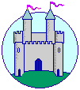
The World of Lords and Vassals
Causes
Governments could not defend people
subordinates (vassals) found a powerful lord who could protect in exchange for service (usually military)
Feudalism
Lord granted land (fief) to the vassal
Vassal provided his fighting skills
Upon death, the fief was supposed to revert to the lord in practice it was inherited by the eldest son

Slide 11
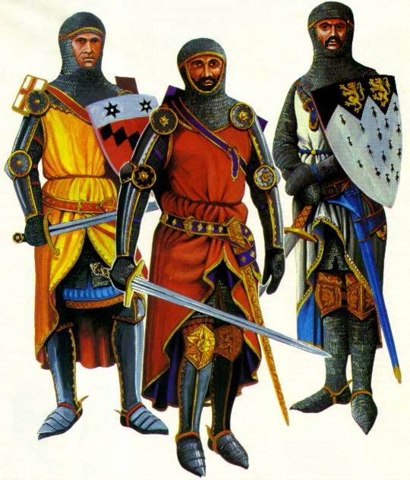
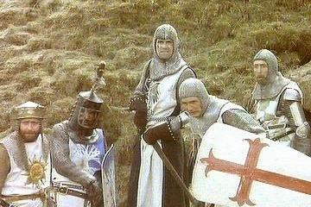
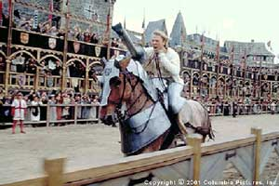
The Knights
Anyone Know the Movie??

Slide 12
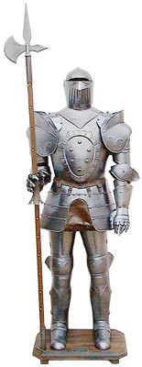
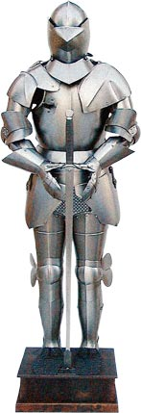
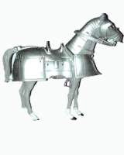
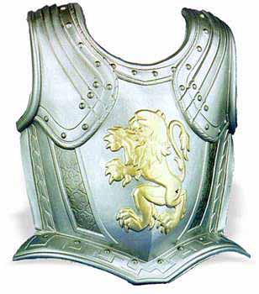

Slide 13
The Age of Chivalry
Knights were expected to display courage in battle and loyalty to their lord.
1100’s → chivalry, a complex set of ideals
Demanded that a knight fight bravely for his three masters; (1) feudal lord, (2) heavenly Lord, (3) his chosen lady
Also protect the weak and the poor
Education started at age 7 (page), then 14 (squire), finally at 21 (knighthood)

Slide 14
Feudal Society
The feudal system was based on mutual obligations.
In exchange for military protection, a lord, would give a fief to a vassal
Feudalism depended on the control of land.

Slide 15
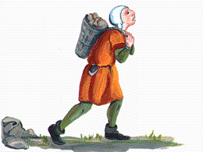
Manorial System
manor
an agricultural estate operated by a lord
worked by peasants
Lords provided protection
peasants gave up freedom
serfs
By the 9th century around 60% of the population
could not be bought and sold
were subject to their lord
had to pay rent to the lord
pay a tithe (10% of produce) to the church
pay for the use of pastures,
streams, woods, etc.

Slide 16
Manorial System
Peasants rarely travelled more than 25 miles from their own manor
Could see their whole world in front of them
Typically consisted of lord’s manor house, a church, and workshops
Fields, pastures, and forests surrounded the village
Along with streams, wells, ponds
Extremely self-sufficient
Serfs and peasants raised or produced nearly everything that they and their lord needed for daily life
Only outside purchases were salt, iron, and a few unusual objects

Slide 17
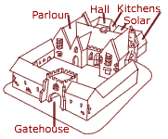
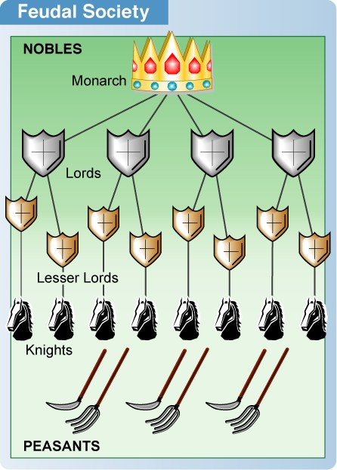
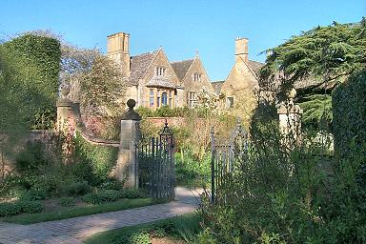
15th Century Manor
English Manor

Slide 18
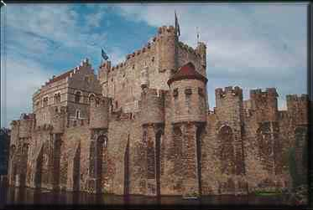
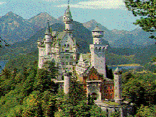

Slide 19
Create your own manor…
With a partner you are going to create a medieval manor.
There are 10 necessary things that you need to include on your manor.
You can use the map on page 326/362 to help guide you but it is not a tell-all source of what you need.
Village
Manor House
Church
Mill
Water Source
Three-Field System
Forest
Orchard
Oven
Roads

