Slide 1
The Early Cold War: 1947-1970

Slide 2
Part I: “Reconstruction & Confrontation”

Slide 3
The Ideological Struggle
Soviet & Eastern Bloc Nations [“Iron Curtain”]
US & the Western Democracies
GOAL → spread world-wide Communism
GOAL → “Containment” of Communism & the eventual collapse of the Communist world. [George Kennan]
METHODOLOGIES:
Espionage [KGB vs. CIA]
Arms Race [nuclear escalation]
Ideological Competition for the minds and hearts of Third World peoples [Communist govt. & command economy vs. democratic govt. & capitalist economy] → “proxy wars”
Bi-Polarization of Europe [NATO vs. Warsaw Pact]

Slide 4
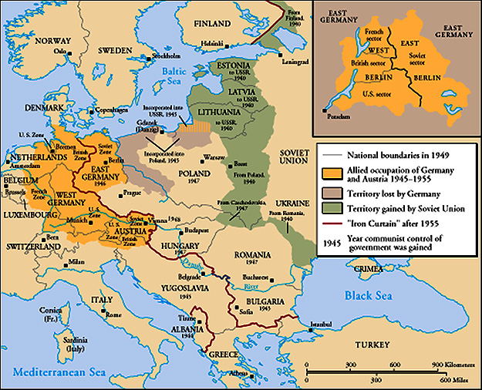
The “Iron Curtain”
From Stettin in the Balkans, to Trieste in the Adriatic, an iron curtain has descended across the Continent. Behind that line lies the ancient capitals of Central and Eastern Europe. -- Sir Winston Churchill, 1946

Slide 5
Truman Doctrine [1947]
Civil War in Greece.
Turkey under pressure from the USSR for concessions in the Dardanelles.
The U. S. should support free peoples throughout the world who were resisting takeovers by armed minorities or outside pressures…We must assist free peoples to work out their own destinies in their own way.
The U.S. gave Greece & Turkey $400 million in aid.

Slide 6
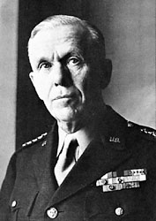
Marshall Plan [1948]
“European Recovery Program.”
Secretary of State, George Marshall
The U. S. should provide aid to all European nations that need it. This move is not against any country or doctrine, but against hunger, poverty, desperation, and chaos.
$12.5 billion of US aid to Western Europe extended to Eastern Europe & USSR, [but this was rejected].

Slide 7
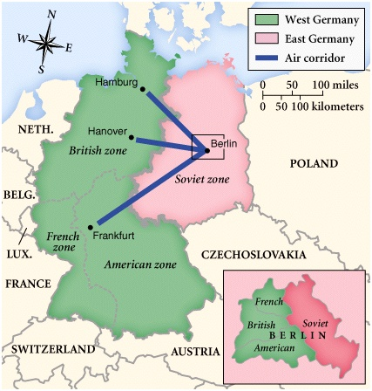
Post-War Germany

Slide 8
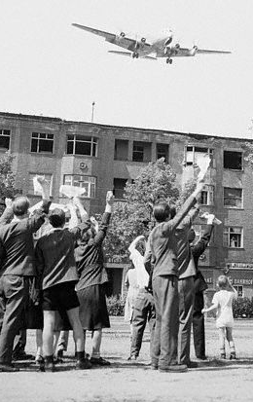
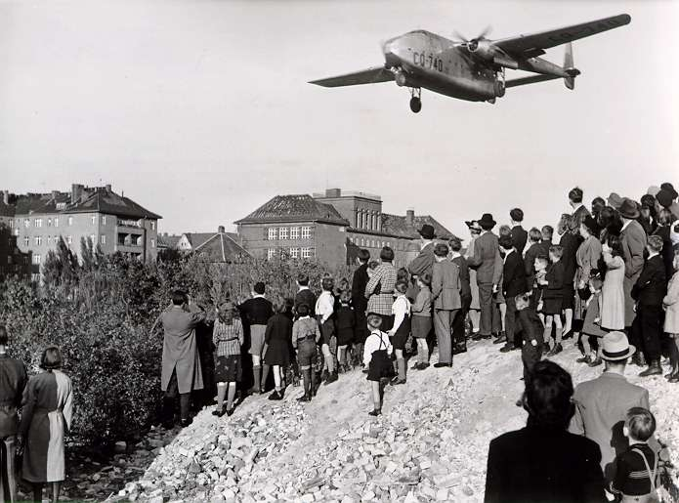
Berlin Blockade & Airlift (1948-49)

Slide 9
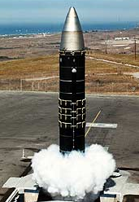
The Arms Race: A “Missile Gap?”
The Soviet Union exploded its first A-bomb in 1949.
Now there were two nuclear superpowers!

Slide 10
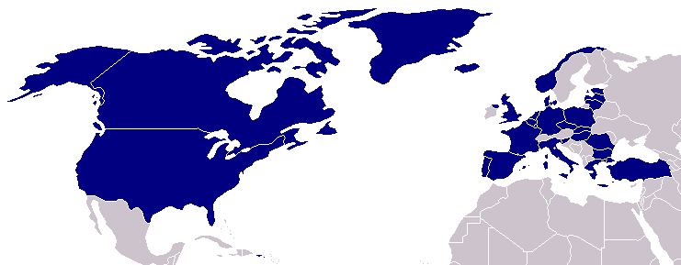
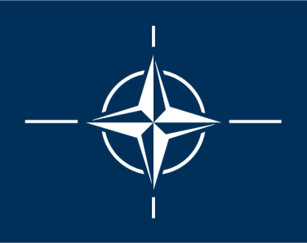
North Atlantic Treaty Organization (1949)
United States
Belgium
Britain
Canada
Denmark
France
Iceland
Italy
Luxemburg
Netherlands
Norway
Portugal
1952: Greece & Turkey
1955: West Germany
1983: Spain

Slide 11
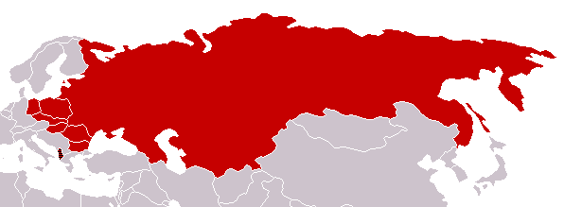
Warsaw Pact (1955)
U. S. S. R.
Albania
Bulgaria
Czechoslovakia
East Germany
Hungary
Poland
Rumania

Slide 12
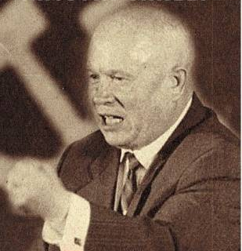
Premier Nikita Khrushchev
About the capitalist states, it doesn't depend on you whether we (Soviet Union) exist. If you don't like us, don't accept our invitations, and don't invite us to come to see you. Whether you like it our not, history is on our side. We will bury you. -- 1956
De-Stalinization Program

Slide 13
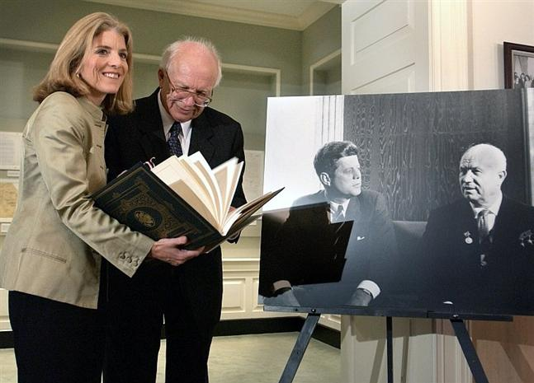
An Historic Irony: Sergei Khrushchev, American Citizen
Who buried who?

Slide 14
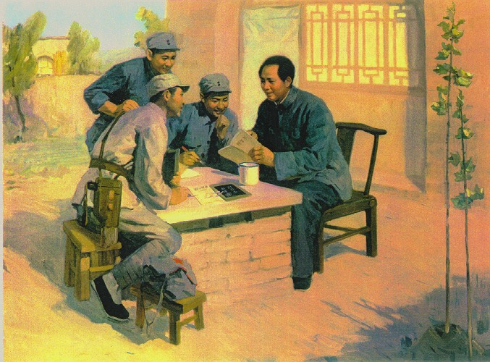
Mao’s Revolution: 1949
Who lost China? – A 2nd } Power!

Slide 15
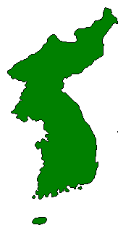
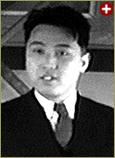
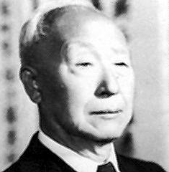
The Korean War: A “Police Action” (1950-1953)
Kim Il-Sung
Syngman Rhee
“Domino Theory”

Slide 16
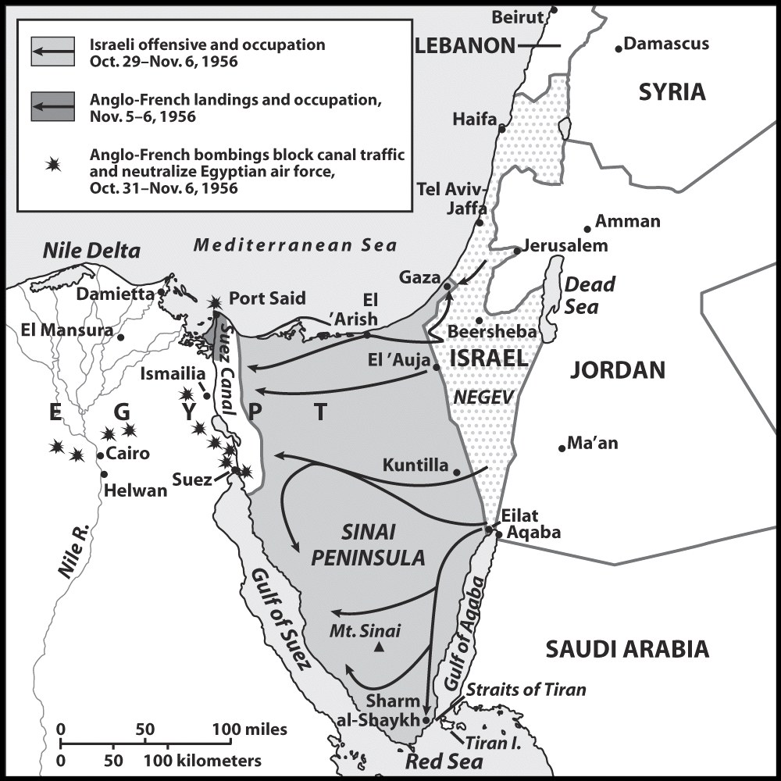
The Suez Crisis: 1956-1957

Slide 17
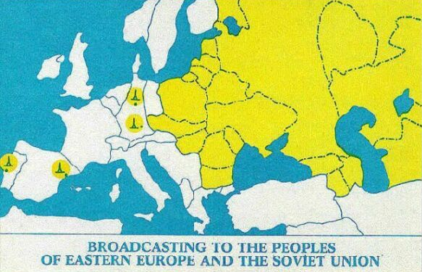
Radio Free Europe/Radio Liberty

Slide 18
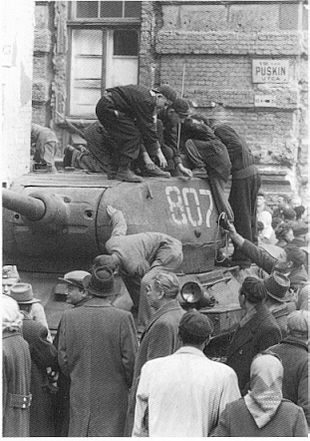
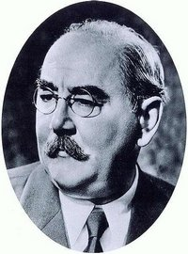
The Hungarian Uprising: 1956
Imre Nagy, Hungarian Prime Minister
Promised free elections.
This could lead to the end of communist rule in Hungary.

Slide 19
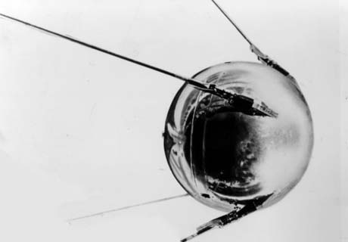
Sputnik I (1957)
The Russians have beaten America in space—they have the technological edge!

Slide 20
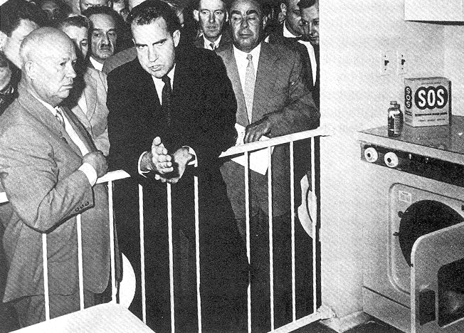
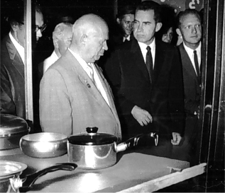
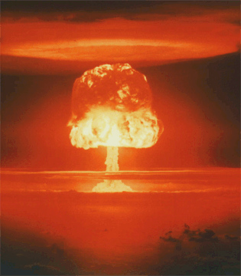
Nixon-Khrushchev “Kitchen Debate” (1959)
Cold War ---> Tensions
<--- Technology & Affluence

Slide 21
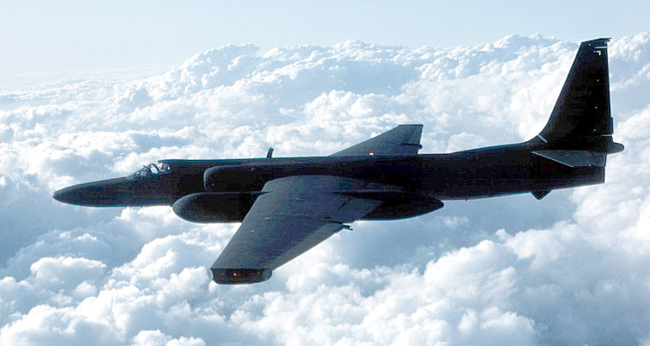
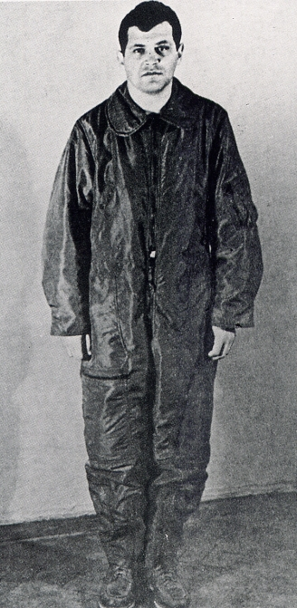
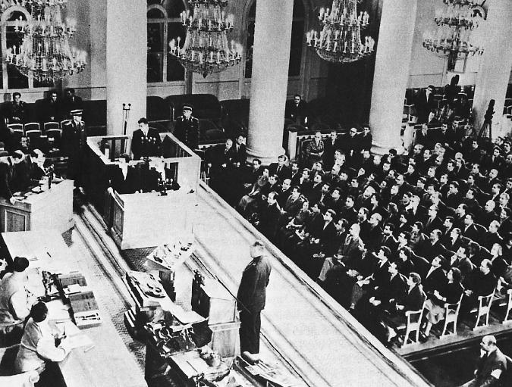
U-2 Spy Incident (1960)
Col. Francis Gary Powers’ plane was shot down over Soviet airspace.

Slide 22
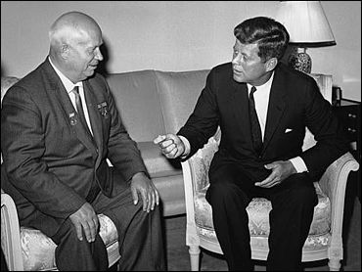
Paris, 1961
Khrushchev & JFK meet to discuss Berlin and nuclear proliferation. Khrushchev thinks that JFK is young, inexperienced, and can be rolled.

Slide 23
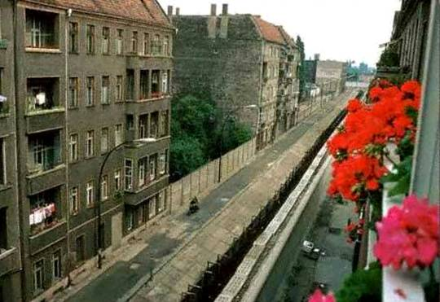
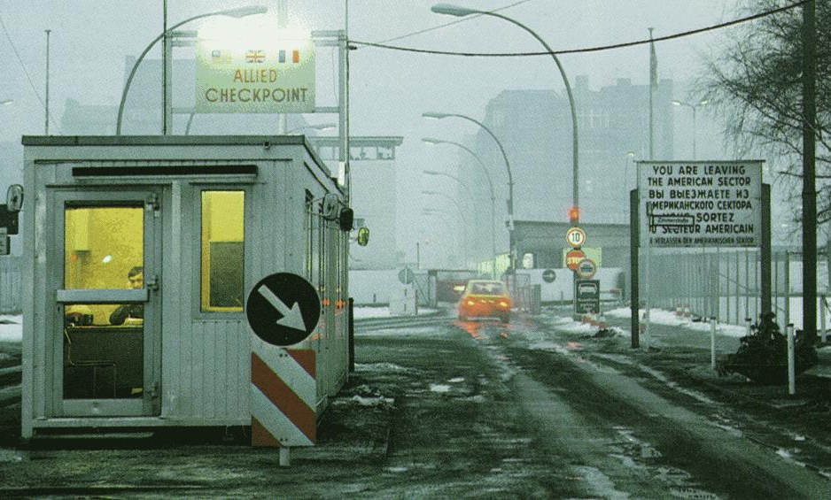
The Berlin Wall Goes Up (1961)
Checkpoint Charlie

Slide 24
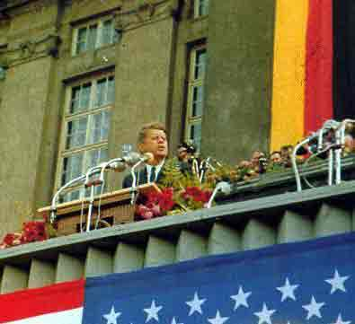
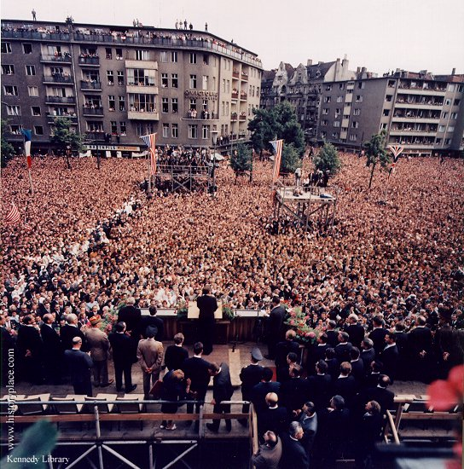
Ich bin ein Berliner! (1963)
President Kennedy tells Berliners that the West is with them!

Slide 25
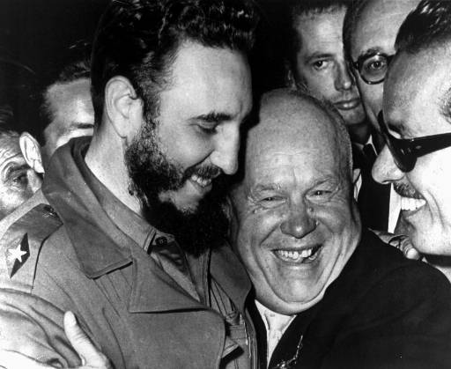
Khruschev Embraces Castro, 1961

Slide 26
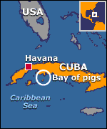
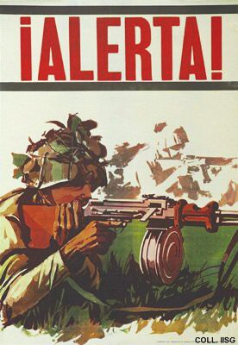
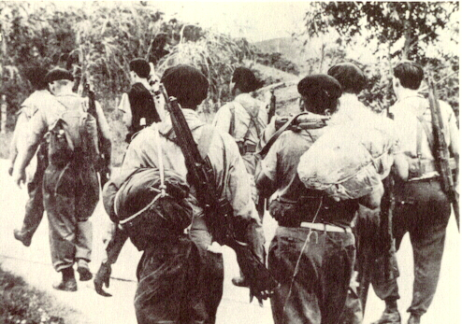
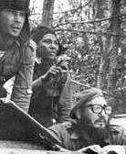
Bay of Pigs Debacle (1961)

Slide 27
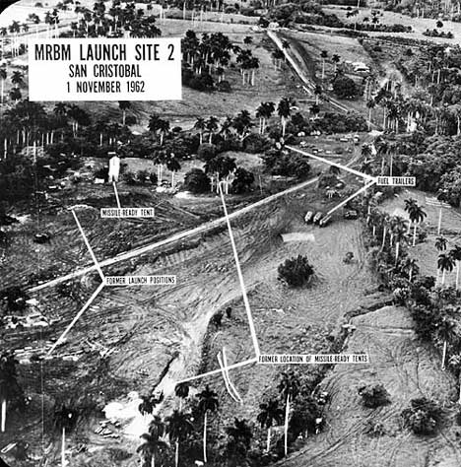
Cuban Missile Crisis (1962)

Slide 28
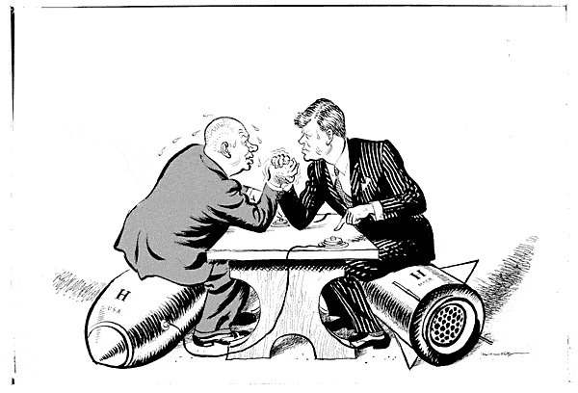
Cuban Missile Crisis (1962)
We went eyeball-to-eyeball with the Russians, and the other man blinked!

Slide 29
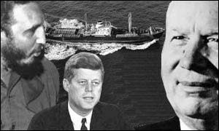
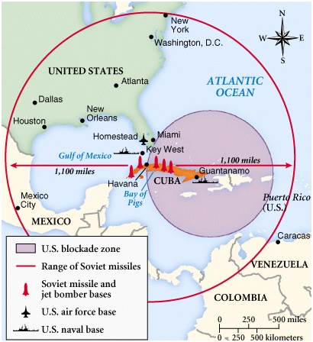
Cuban Missile Crisis (1962)

Slide 30
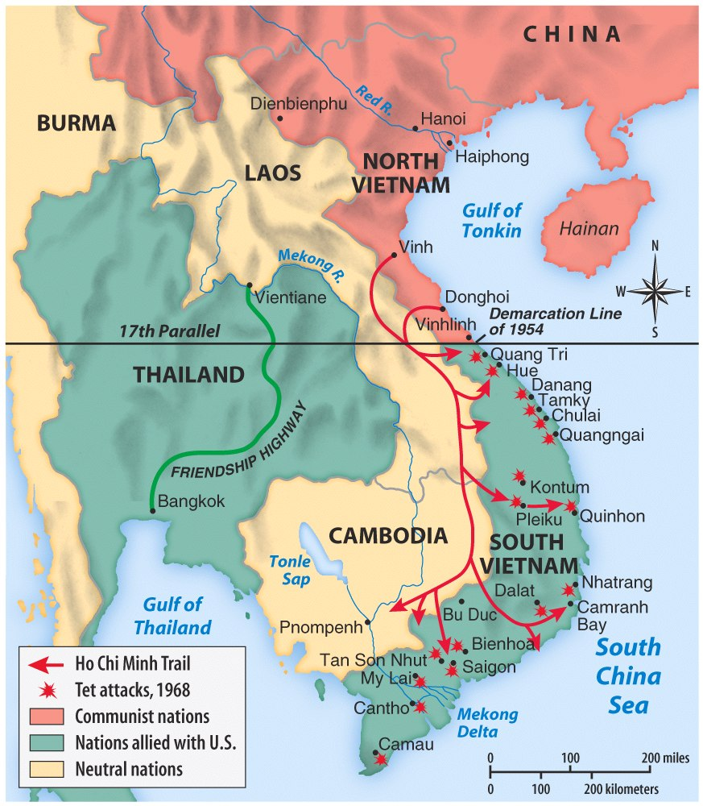
Vietnam War: 1965-1973

Slide 31
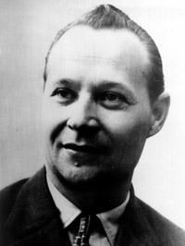
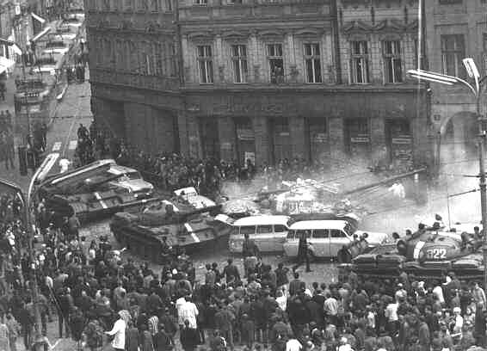
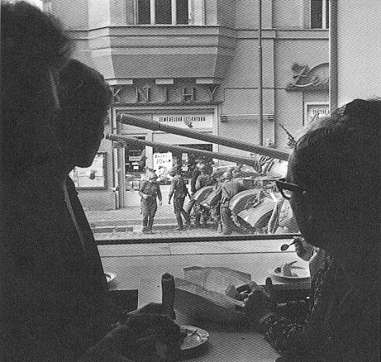
“Prague Spring” (1968)
Former Czech President, Alexander Dubček
Communism with a human face!

Slide 32
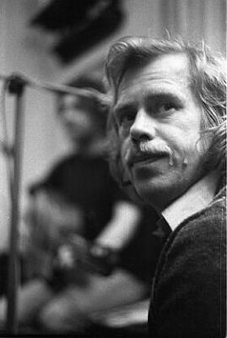
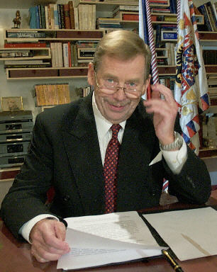
“Prague Spring” Dashed!
Dissidents/playwrights arrested [like Vaclav Havel—future president of a free Czech Republic].

Slide 33
4th French Republic: 1945-1958
Democratic, but politically unstable [27 governments!]
Universal suffrage.
Weak President; powerful legislature
Many political parties [coalition governments]
Failure to gracefully leave Indochina.
Botched the Suez War.
Failed to settle the Algerian Crisis.

Slide 34
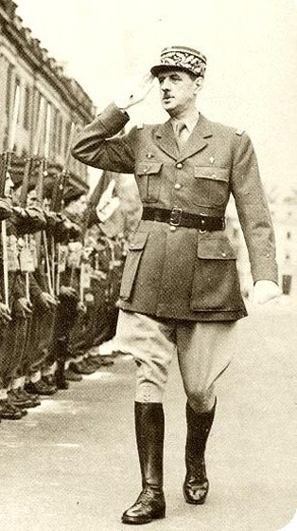
5th French Republic (1958-Present)
Powerful President. * first: Charles DeGaulle
Weak Cabinet.
Weakened legislature.
Separation of powers.

Slide 35
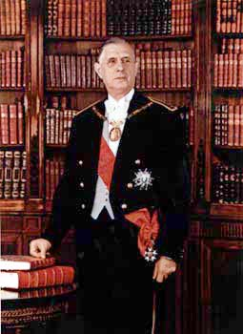
DeGaulle’s Achievements
Settled the Algerian Crisis.
Made France a nuclear power.
Sustained general prosperity.
Maintained a stable, democratic government.
Made France more politically independent.
BUT, late ’60s student unrest and social changes challenged him. In 1968 he resigned & died of a heart attack in 1970.

Slide 36
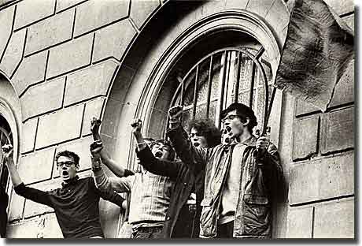
Student Riots in Paris (May, 1968)

Slide 37
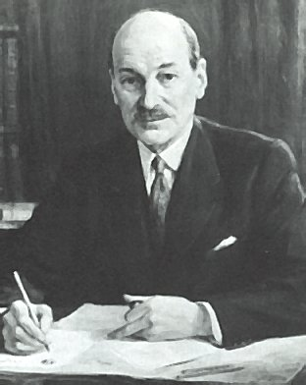
Clement Attlee & the Labor Party: 1945-1951
Limited socialist program [modern welfare state].
Natl. Insurance Act
Natl. Health Service Act
Nationalized coal mines, public utilities, steel industry, the Bank of England, RRs, motor transportation, and aviation.
Social insurance legislation: “Cradle-to-Grave” security.
Socialized medicine → free national health care.

Slide 38
Clement Attlee & the Labor Party: 1945-1951
Britain is in a big debt!
The beginning of the end of the British Empire.
India – 1947
Palestine – 1948
Kenya → Mau Mau uprising - 1955

Slide 39
Churchill Returns: 1951-1955
He never really tried to destroy the “welfare state” established by Attlee’s government.

Slide 40
The Federated Republic of Germany
Created in 1949 with the capital at Bonn.
Its army limited to 12 divisions [275,000].
Konrad Adenauer, a Christian Democrat, was its 1st President.
Coalition of moderates and conservatives.
Pro-Western foreign policy.
German “economic miracle.”
“Father of Modern Germany.”

Slide 41
Italy After WW II
Alcide de Gasperi was Italy’s P.M. from 1948-1953
Coalition governments [short and unstable!]

Slide 42
Part II: “European Union”

Slide 43
European Economic Integration
1947 → General Agreement on Tariffs and Trade [GATT]
23 nations.
Became the foundation of postwar global commerce.
It set up procedures to handle commercial complaints.
It provided a framework for continuing negotiations [“rounds”].
By 1990, 99 nations were participating.

Slide 44
European Economic Integration
1952 → European Coal & Steel Community [ECSC].
HQ in Luxembourg.
“Inner Six” → Benelux nations, France, Italy, W. Germany.
Placed their coal and steel industries under a form of supranational authority.
Eliminated tariff duties and quotas on coal and steel.

Slide 45
European Economic Integration
1957 → European Economic Community [EEC]
HQ → Brussels.
Treaty of Rome.

Slide 46
European Economic Integration
1957 → European Economic Community [EEC]
France, W. Germany, Italy, Benelux.
Created a larger free trade area, or customs union.
Eliminate all trade barriers.
One common tariff with the outside world.
Free movement of capital & labor.

Slide 47
European Economic Integration
1967 → combined the ECSC & EEC to form the European Community [EC].
HQ → Brussels.
European Parliament.
“Eurocrats.”
518 members [elected by all voters in Europe].
Only limited legislative power.
Court of Justice.

Slide 48
European Economic Integration
1991-92 → Maastricht Agreements
European Union [EU] created from the EC.
One currency, one culture, one social area, and one environment!
Create a “frontier-free” Europe → a common EU passport.
One large “common market.”
Goods coming into the EU would have high tariffs placed on them.
2002 → a common currency [Euro]
2003 → 60,000 men EU rapid defense force was created.

