Slide 1
The Northern Renaissance

Slide 2
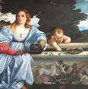
Late Beginning
Moved slowly to the north
North had been recovering from the plague
Ideas spread
trade
Monarchs sponsored art
Used social reform and religious ideas

Slide 3
Artistic Ideas Spread
Italian artists left war torn Italy in late-1400s bringing ideas with them.
German Painters
Albrecht Durer: went to Italy and studied art, brought ideas back with him → realism
Flemish Painters
Jan van Eyck → oil-based paintings, can blend easily with other colors
Pieter Bruegel → everyday life, realistic detail

Slide 4
Renaissance Writers
Renaissance writers produced works that reflected their time but techniques that are still used today.
Vernacular → native language
Wrote for self-expression or to portray the individuality of their subjects.
Popular subjects: politics, parody, comedy, poetry

Slide 5
Northern Writers Reform Society
Influence came from Italy but with more of a religious slant → Christian Humanism.
Christian Humanists
Desiderius Erasmus: Christianity of the heart, all must study Bible
Thomas More: tried to show a better model for society, Utopia
Francois Rabelais: poked fun at his society.

Slide 6
Northern Writers Cont’d.
William Shakespeare
deep understanding of human beings.
Wrote both tragedies and comedies → examine flaws
Drew on classics for inspiration and plots

Slide 7
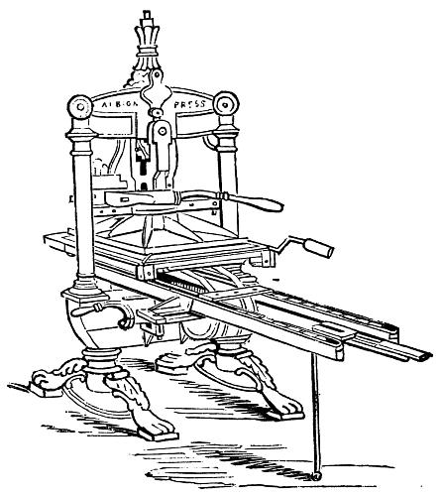
Printing helps spread new ideas
Johann Gutenberg
Created a machine based on movable type.
Gutenberg Bible → first full book of printed type
Printing Spreads Learning
Books were now cheap enough for everyone
Rise in literacy
End of the Renaissance
New artistic styles and ideas appeared but Renaissance ideas continued to influence.

Slide 8
Artist & Writer Assignment
You will create two posters (one on the front and one on the back).
Each person will be assigned an artist and a writer.
The poster must include:
Name of person
Country they are from
If they are artist or writer
Name of their famous work(s)
A picture (artists = picture of famous work, writer = picture of writer)
You should be able to get everything from the book

Slide 9
Writers
1. Niccolo Machiavelli
2. Thomas More
3. William Shakespeare
4. Erasmus
Artists
1. Michelangelo
2. Van Eyck
3. Leonardo da Vinci
4. Raphael

