Slide 1
Two Superpowers Face Off

Slide 2
The Ideological Struggle
Soviet & Eastern Bloc Nations [“Iron Curtain”]
US & the Western Democracies
GOAL → spread world-wide Communism
GOAL → “Containment” of Communism & the eventual collapse of the Communist world.
Methodologies:
Espionage
Arms Race
Communist govt. & command economy vs. democratic govt. & capitalist economy
NATO v. Warsaw Pact

Slide 3
Former Allies Diverge
A Joint Postwar Plan
US, GB, and USSR meet at Yalta to discuss postwar plans
Divide Germany into zones of occupation controlled by Allied forces
Germany pay USSR for losses
Stalin promised Eastern Europeans free elections with a “policy friendly to Russia” → Churchill knew he was lying through his teeth
Creation of the U.N.
The Big 2 joined with 48 other countries to create UN
Based in NY, “pledged to save succeeding generations from the scourge of war.”

Slide 4
Former Allies Diverge
The UN
Everybody part of the General Assembly
11-member body called the Security Council had the real power to investigate and settle disputes
5 permanent members: GB, China, France, US, USSR
Each could veto any Security Council action
This provision was intended to prevent any members of the Council from voting as a bloc to override the others.
The US and USSR have slightly different goals
US → only 400,000 deaths, cities & factories intact
USSR → 50X the losses of US, cities demolished
With these situations and different political and economic views led to contradictory ideas

Slide 5
Superpower Aims in Europe
United States | Soviet Union
Encourage democracy in other countries to help prevent the rise of Communist governments | Encourage communism in other countries as part of a worldwide workers’ revolution
Gain access to raw materials and markets to fuel booming industries | Rebuild its war-ravaged economy using Eastern Europe’s industrial equipment and raw materials.
Rebuild European governments to promote stability and create new markets for American goods | Control Eastern Europe to protect Soviet borders and balance the US influence in Western Europe
Reunite Germany to stabilize it and increase the security of Europe | Keep Germany divided to prevent its waging war again

Slide 6
The Soviet Union Corrals Eastern Europe
Soviets Build a Wall of Satellite Nations
Soviets always scared of the West
Stalin, as predicted, ignored the agreement in Yalta and did not allow free elections → claimed he needed a buffer
Churchill, Stalin, and Truman met at Potsdam → Truman urged Stalin, Stalin said no and stated war was inevitable
Iron Curtain divides East and West
Churchill described the division of Europe between the Baltic Sea to the Adriatic an “iron curtain” has been erected.

Slide 7
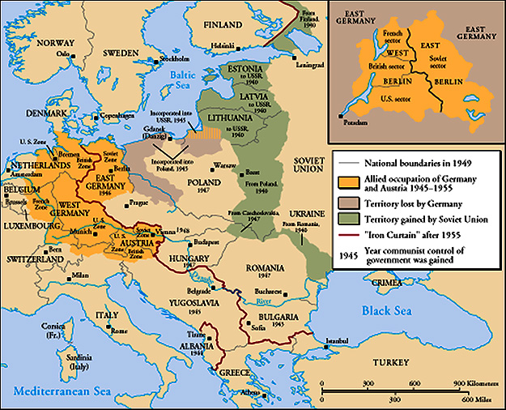
The “Iron Curtain”
From Stettin in the Balkans, to Trieste in the Adriatic, an iron curtain has descended across the Continent. Behind that line lies the ancient capitals of Central and Eastern Europe. -- Sir Winston Churchill, 1946

Slide 8
United States Counters Soviet Expansion
Truman declared a foreign policy called containment.
Directed at blocking Soviet influence and preventing the expansion of communism.
Included creating alliances and helping weak countries
Truman Doctrine
Support for countries that rejected communism
Extremely controversial: should not get involved with other nations, not enough resources, support going to some dictators, etc.

Slide 9
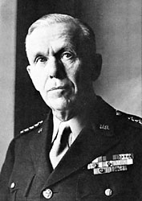
United States Counters Soviet Expansion
The Berlin Airlift
Argument b/w US and USSR over Germany
USSR wanted Germany split to keep it down
US, France, GB allow West Germany to form
USSR cuts off Berlin → hope Berlin would surrender
American and British officials flew food and supplies for nearly 11 months
Planes took off and landed every 3 minutes
277,000 flights ~ 2.3 million tons of supplies
Soviets lifted the Berlin blockade
The Marshall Plan
Sec. of State George Marshall proposed that America give aid to any European country that needed it.
Provide food, machines, and other materials

Slide 10
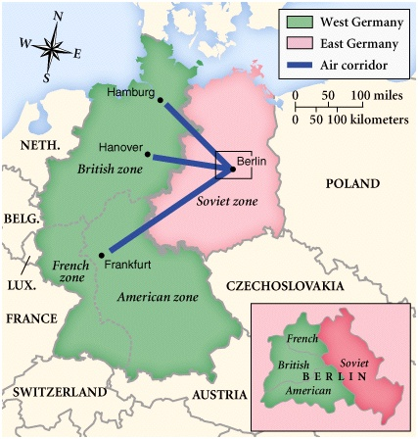
Postwar Germany

Slide 11
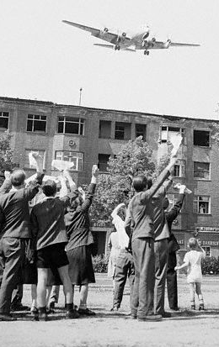
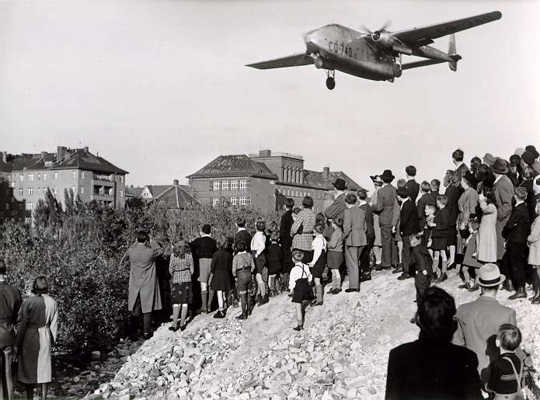
Berlin Blockade and Airlift (1948-49)

Slide 12
The Cold War and a Divided World
Beginning of Cold War in 1949
Use of espionage, propaganda, diplomacy, and secret operations
Rival Alliances
NATO → ten Western European nations, US, and Canada.
Promised to respond to attack with armed force
Warsaw Pact → Soviet Union alliances with Poland, E. Germany, Czech, E. Europe
China and India remained neutral

Slide 13
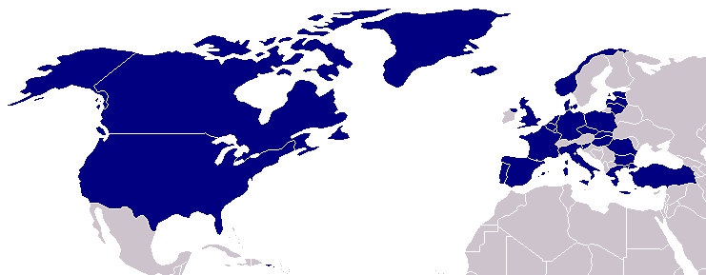
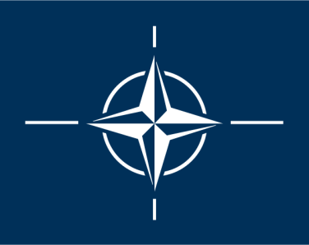
North Atlantic Treaty Organization (1949)
United States
Belgium
Britain
Canada
Denmark
France
Iceland
Italy
Luxembourg
Netherlands
Norway
Portugal
1952: Greece & Turkey
1955: W. Germany
1983: Spain

Slide 14
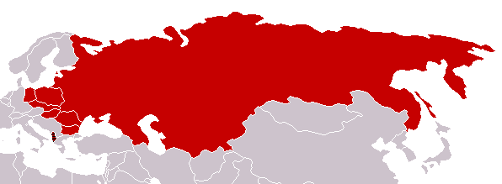
Warsaw Pact (1955)
U.S.S.R.
Albania
Bulgaria
Czechoslovakia
E. Germany
Hungary
Poland
Romania

Slide 15
The Cold War and a Divided World
Nuclear Threat
Both superpowers became nuclear threats
Truman wanted to develop an even more powerful weapon then A-bomb → thermonuclear weaponry
Hydrogen bomb (H-bomb) 1000X > A-bomb
Ike becomes president and his Sec. of State, John Foster Dulles, declares brinkmanship
See who could have the most planes and bombs
The Cold War in the Skies
August ‘57 → USSR develops ICBM
Used to launch first satellite to outer space, Sputnik I
Ike declares “open skies” policy
Leads to U-2 incident

Slide 16
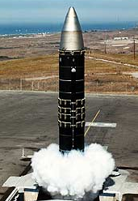
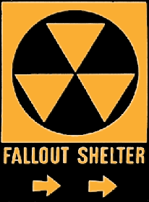
The Arms Race: A “Missile Gap”?
The Soviet Union exploded its first A-bomb in 1949.
Now there were two nuclear superpowers!

